Slide 1
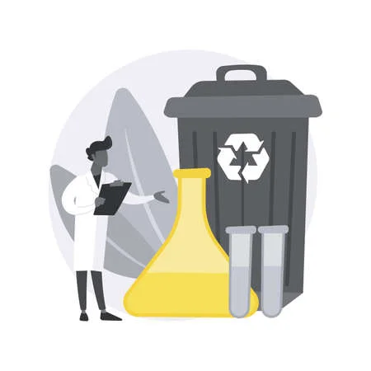


Saint Louis University
Laboratory Waste

Slide 2
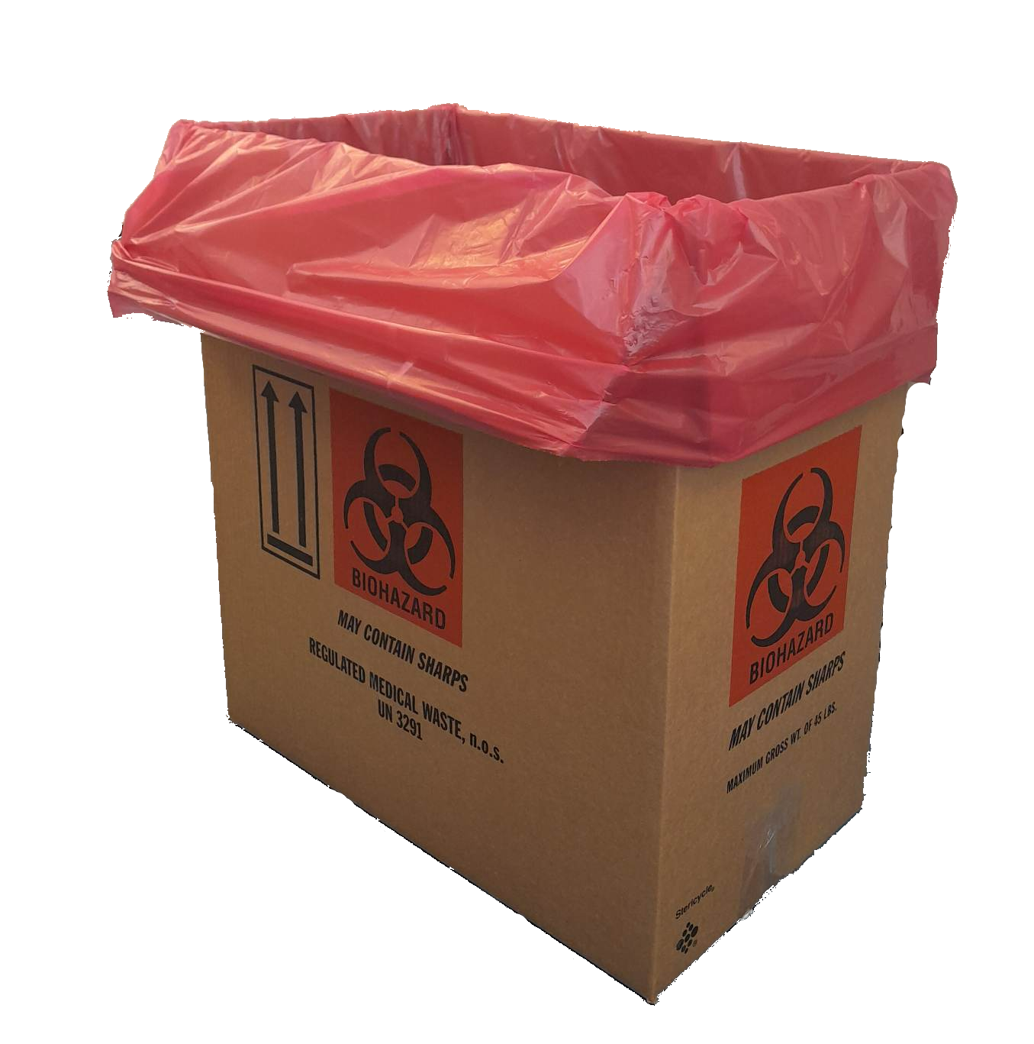
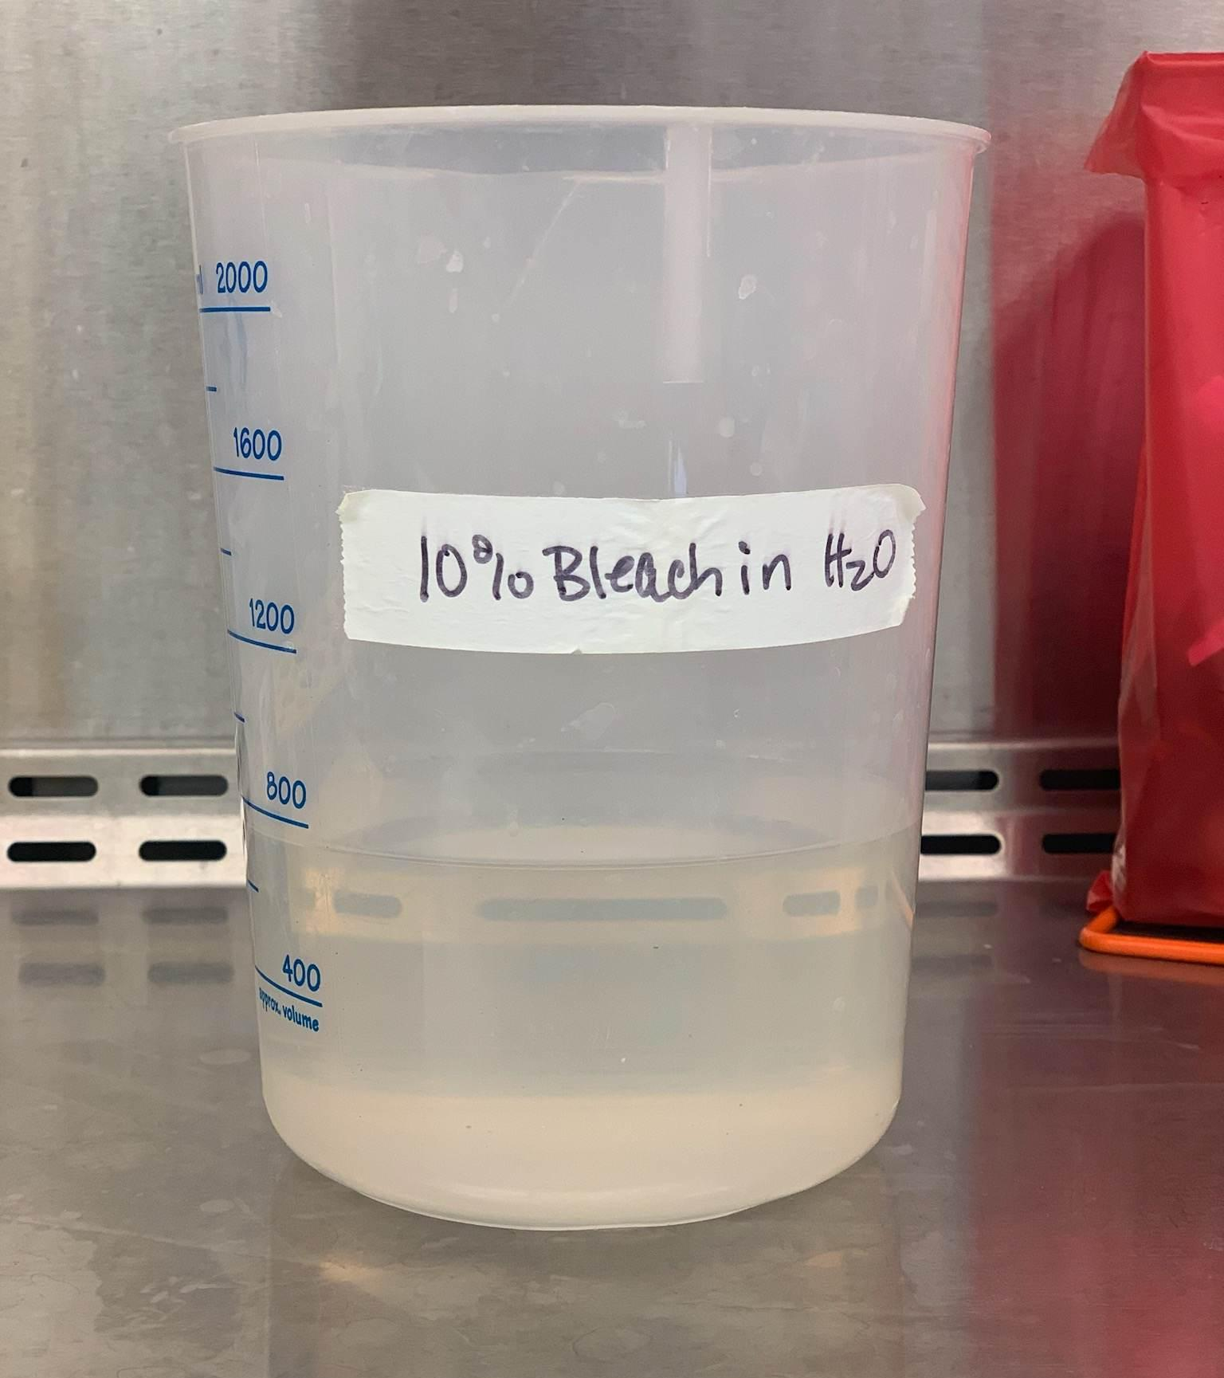
Biohazardous Waste
Solid biohazardous waste (contaminated plastics, used PPE, non-sharps) can be autoclaved or placed into a Stericycle box.
Liquid biohazardous waste should be decontaminated using a 1:9 (10%) final bleach concentration, held overnight* and disposed of down the drain.
* or as approved in specific IBC protocols

Slide 3

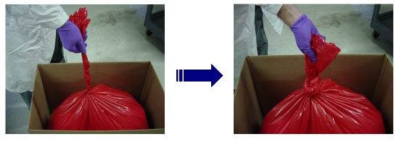
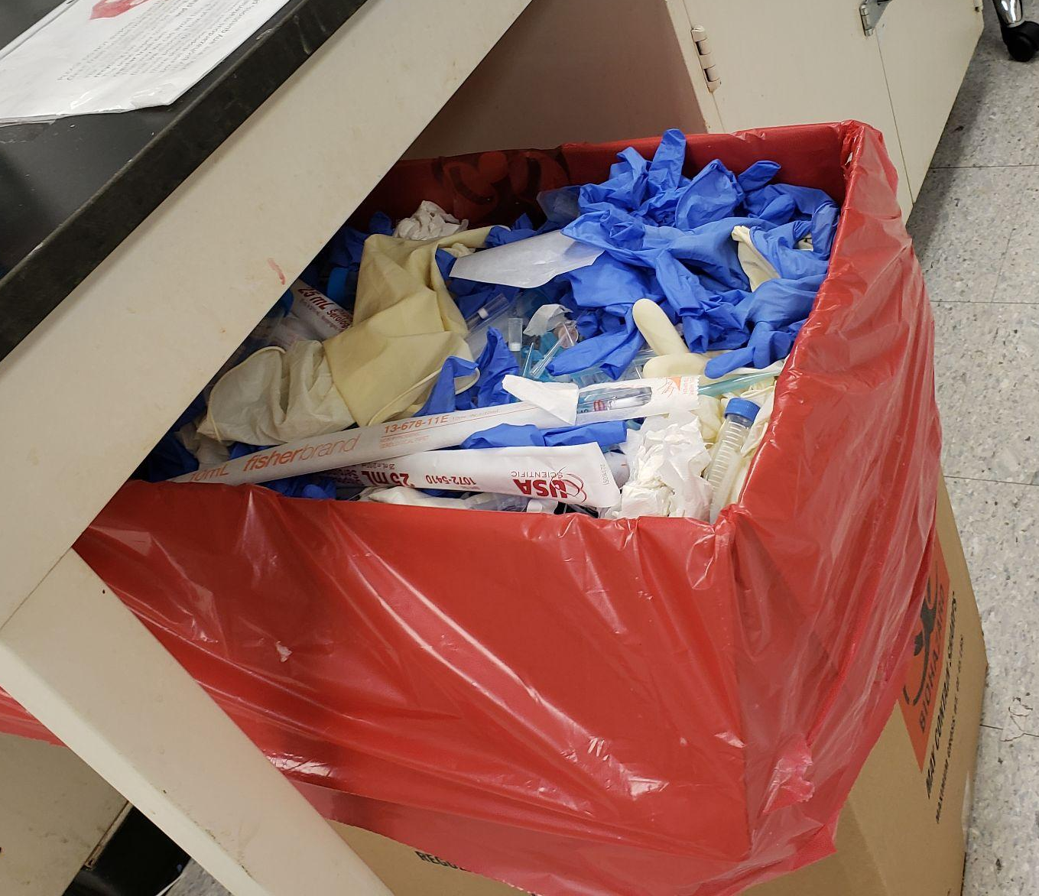
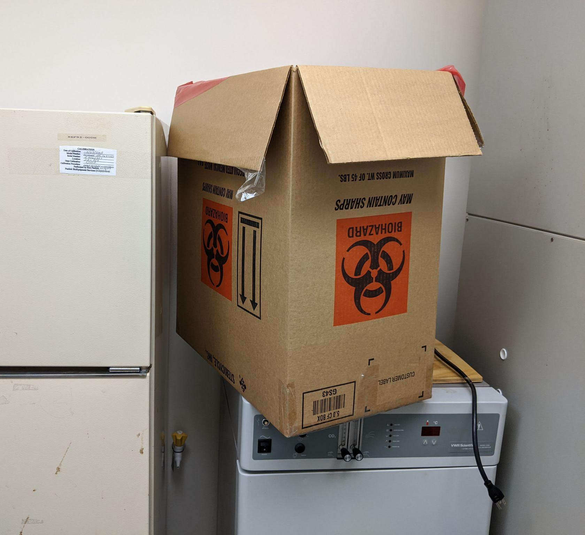
Biohazard Waste Boxes
Biohazard boxes should be upright and taped across the bottom.
Boxes cannot exceed 45 lbs.
Once full, twist and tie red bag in a single knot, tape box across the top and place barcode label in the designated location on the box.
Complete the Biological Waste Removal Form on the SLU EHS website when ready for pick-up.
Stericycle biohazard boxes and labels are provided by EHS. Please use the above form or contact biowaste@slu.edu to request additional boxes or labels.

Slide 4
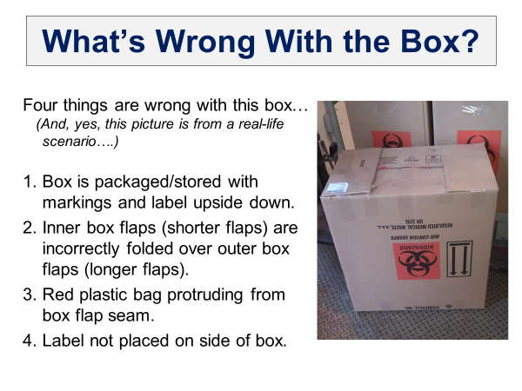
What’s Wrong With this Box?
Four things are wrong with this box…
(and yes, this picture is from a real-life scenario..)
Box is packaged/stored with markings and label upside down.
Inner box flaps (shorter flaps) are incorrectly folded over outer box flaps (longer flaps).
Red plastic bag protruding from box flap seam.
Label not placed on side of box.

Slide 5
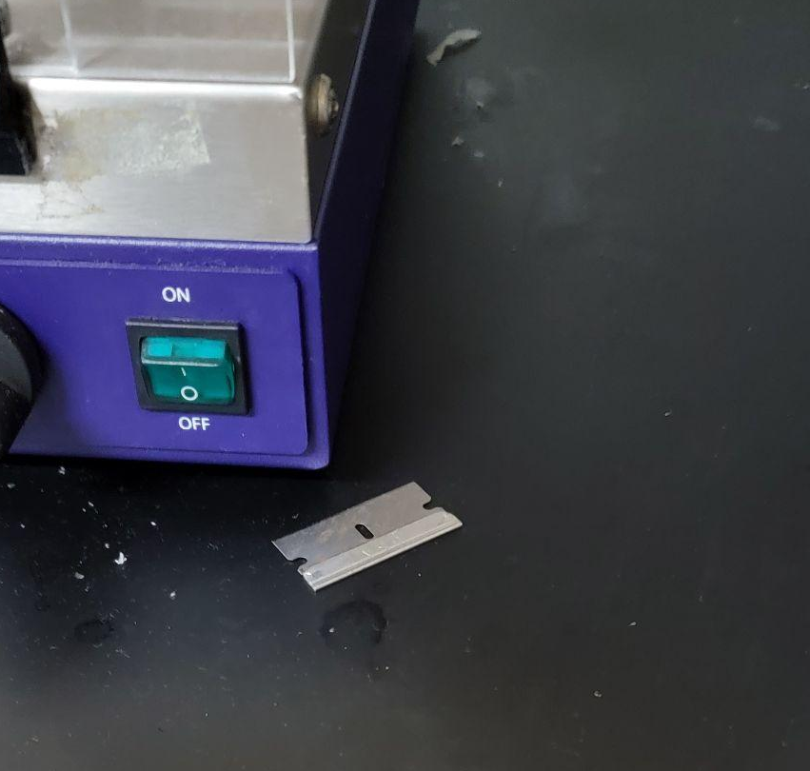
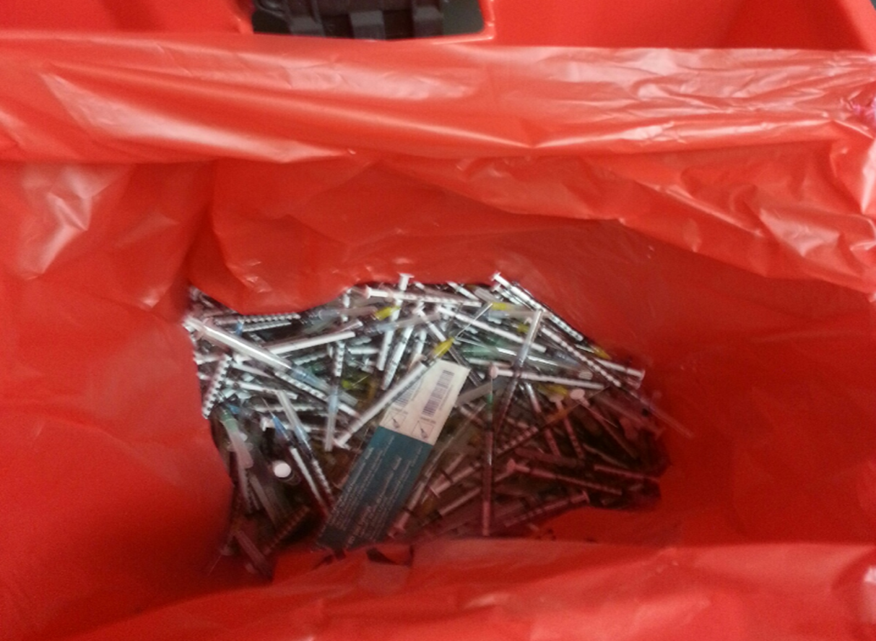
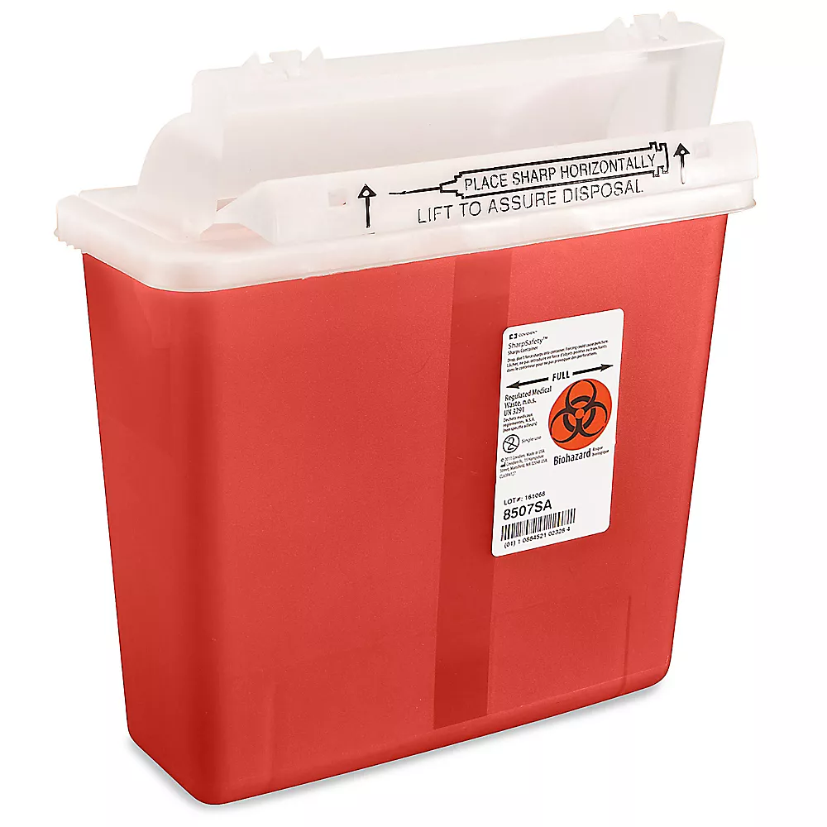
Sharps Disposal
All sharps (scalpels, razor blades, needles, contaminated broken glass) must be disposed of in an approved sharps container. Labs are responsible for the purchase of sharps containers.
Sharps should not be left unattended or exposed in the lab.
Sharps containers ready for disposal must be closed and taped shut. They must be placed into a Stericycle biohazard box for pick-up, or email biowaste@slu.edu.
Complete the Biological Waste Removal Form on the SLU EHS website when ready for pick-up.

Slide 6
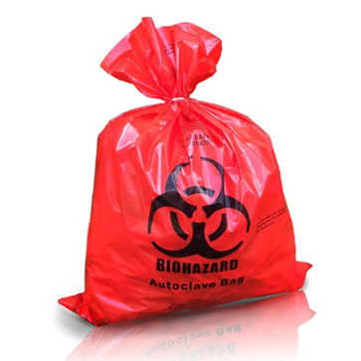
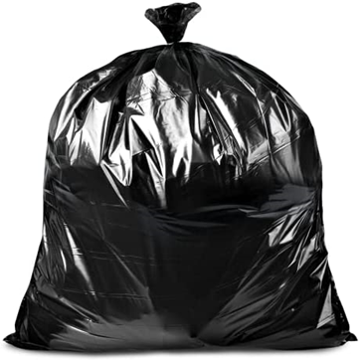
Autoclaving Solid Biohazard Waste
Biohazardous waste can also be collected in a red biohazard bag and autoclaved.
If using this method, autoclaves must be validated weekly, and results need to be documented.
Autoclaved waste is then placed into a black trash bag for regular trash disposal.
after autoclaving

Slide 7
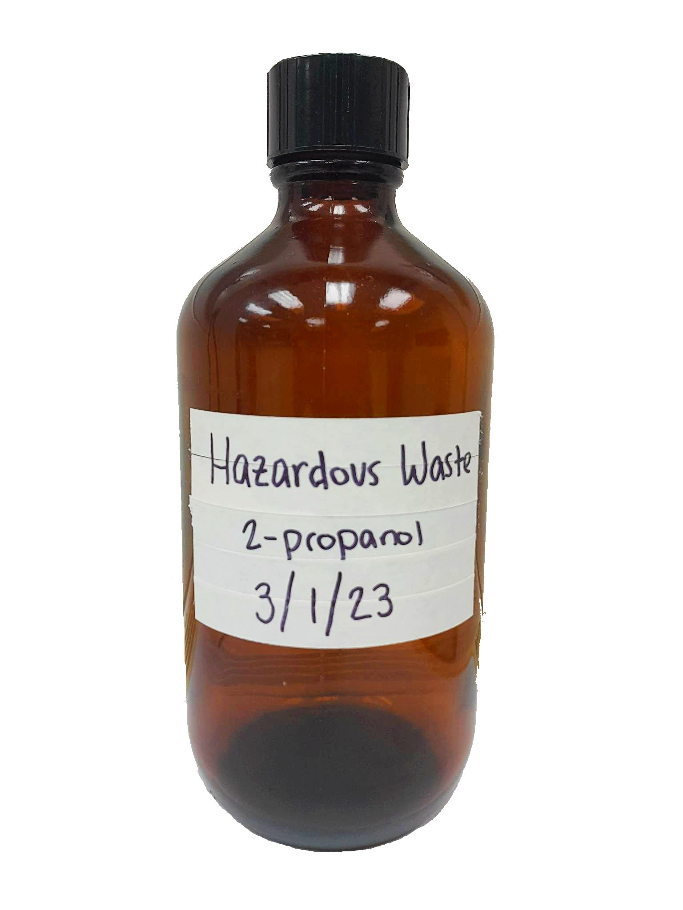
Chemical Waste
All hazardous chemicals must be collected by Environmental Health & Safety for proper disposal.
Drain and regular trash disposal of hazardous chemicals is illegal.
Complete the Chemical Waste Removal form on the SLU EHS website for disposal of:
  Hazardous chemicals
  Unused, spent, unwanted or expired chemicals
Chemical waste containers must be labeled with:
  Hazardous Waste
  All the chemical components
  Start date of accumulation
Contact chemwaste@slu.edu with any questions regarding chemical waste disposal.

Slide 8
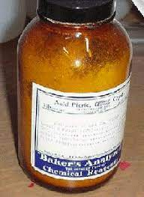
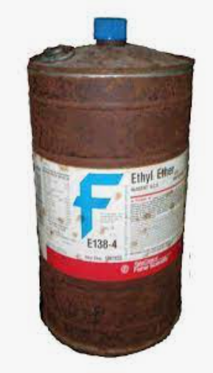
Chemical Waste Safety Concerns
Peroxide forming chemicals must be dated when opened and should not be kept in storage for more than one year and never past the expiration date.
If a chemical begins to show crystallization inside the container, DO NOT OPEN the container. Notify the PI and EHS immediately.
When requesting chemical waste removal of a high hazard chemical, please include a note with the request to ensure all involved are aware of the safety concerns.
  E.g., ethers, picric acid, hydrofluoric acid, bromine, osmium tetroxide, nitric acid, perchloric acid, cyanides.
Do not collect chemical waste in containers > 4 L in size without prior approval from EHS.
Please ensure all chemical waste is labeled, sealed, and can be safely handled prior to requesting a pickup by EHS.

Slide 9
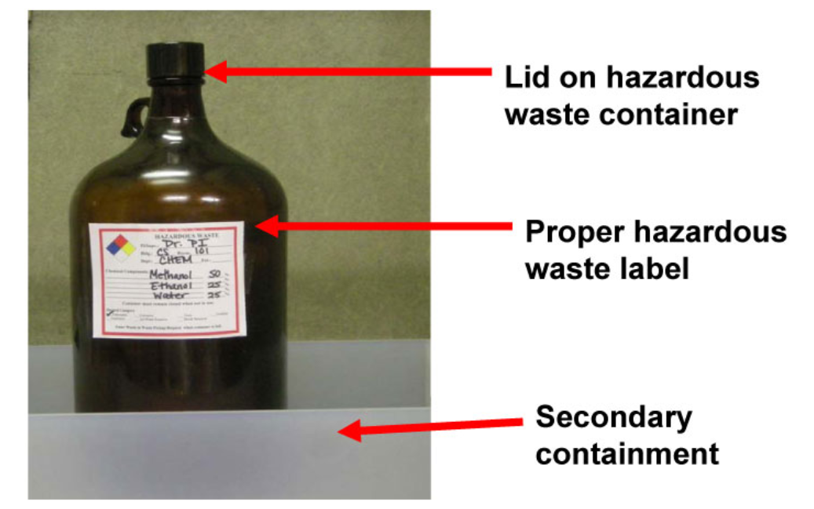
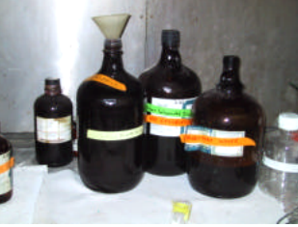
Storing Chemical Waste
Labs are encouraged to store chemical waste containers in or near the chemical fume hood.
Chemical waste should never be stored directly on the floor unless absolutely necessary and only if using secondary containment.
While in storage, chemical waste should be labeled properly at all times. Secondary containment is preferred depending on storage location.
Chemical waste containers should only be open when adding or removing the contents.
Chemical waste containers should never be left in storage with a funnel unless the funnel is designed to contain the liquid and vapor.

Slide 10
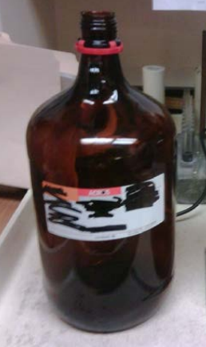
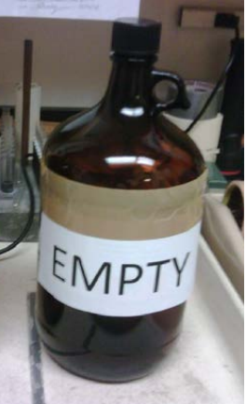
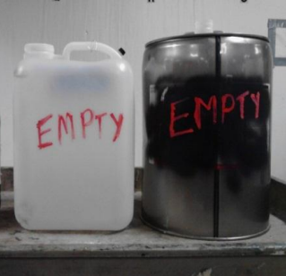
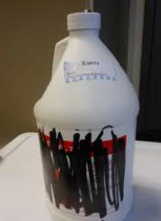
Empty Chemical and Chemical Waste Containers
Empty chemical containers must be free of liquids/solids and clearly marked prior to disposal by housekeeping.
Once empty and triple rinsed, chemical containers can be reused for chemicals or chemical waste.
Examples of appropriate labeling of empty containers:

Slide 11
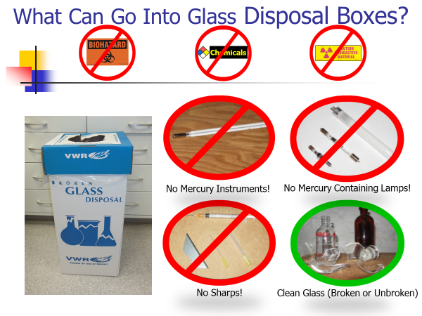
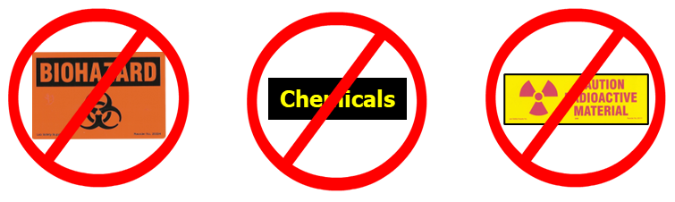
Clean Broken Glass Disposal
Clean broken glass is defined as glass or broken glass that is not contaminated with chemicals, biohazards or radioactive materials.
Broken glass disposal boxes are disposed of in the regular trash dumpsters by housekeeping staff, therefore, the glass must not be contaminated.
Laboratory occupants must ensure the contents are in compliance for regular trash disposal:
  Boxes must be sealed and safe for transport.
  Boxes must weigh less than 45 pounds to allow for safe transport.

Slide 12
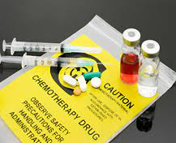
Chemotherapeutic and Cytotoxic Drugs
Chemotherapy and cytotoxic drug wastes are defined as hazardous chemical waste by the EPA and should be incinerated for proper disposal.
  E.g., tamoxifen, cisplatin, cyclophosphamide, bleomycin, doxorubicin, oxaliplatin.
Complete the Chemical Waste Removal Form or contact chemwaste@slu.edu for disposal.
If chemotherapeutic or cytotoxic drug waste becomes contaminated with a biohazard, you must follow the approved chemical SOP or the approved IBC protocol for proper handling and disposal.
Do not dispose of chemotherapeutic and cytotoxic drugs in biohazard waste unless this disposal method has been approved by EHS.
CHEMICAL
DISPOSAL
BIOHAZARD
DISPOSAL

Slide 13
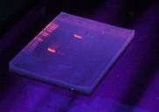
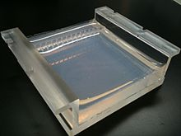
Ethidium Bromide Waste
Ethidium bromide is a mutagen, teratogen and suspected carcinogen which must be handled as chemical waste, not a biohazardous waste.
Stock solutions of ethidium bromide typically contain ~10 mg/ml of ethidium bromide.
Solid ethidium bromide waste (e.g., gels) and buffers typically contain <5 ug/ml of ethidium bromide.
  Gels with <0.5 ug/ml of ethidium bromide can be bagged and placed in the regular laboratory trash.
  Buffers with <0.5 ug/ml of ethidium bromide can be released to the sewer; charcoal filtration is recommended.
Gels, buffers and stock solutions containing ≥0.5 ug/ml of ethidium bromide must be stored in closed, labeled containers. Contact EHS for pickup.

Slide 14
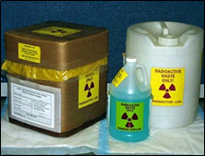
Radioactive Waste
Ensure that radioactive waste is appropriately shielded (Plexiglass for strong beta emitters, lead for gamma/x-ray emitters).
For liquid waste use secondary containment to prevent spills should the primary container leak.
Separate radioactive waste by radionuclide and waste stream.
  E.g., scintillation vials separate from dry waste.
Wear appropriate PPE when handling waste (gloves, lab coat, protective eyewear, etc.).
Wear radiation dosimeters while handling high energy beta and gamma/x-ray radioactive waste.
Detailed radioactive waste packaging instructions can be found
on the EHS website here.
To request a radioactive waste pickup, complete the
Radioactive Waste Removal form found on the EHS website.

Slide 15
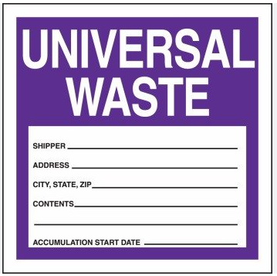
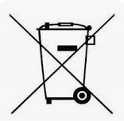
Universal Waste
Universal waste is a category of waste materials regulated by the EPA and designated as hazardous waste. Although these are common items found in every research and teaching lab, they must be managed properly.
Universal waste includes batteries, lamps, pesticides, aerosols and mercury-containing equipment.
  At SLU all pesticides and aerosols are treated as hazardous chemical waste and should be collected by EHS for proper disposal.
  Mercury containing equipment (thermostats, barometers, mercury switches, old mercury thermometers and certain medical equipment) are treated as hazardous chemical waste and should be collected by EHS for proper disposal.
  Contact ehs@slu.edu to trade in your old mercury thermometer for a comparable alcohol thermometer.

Slide 16
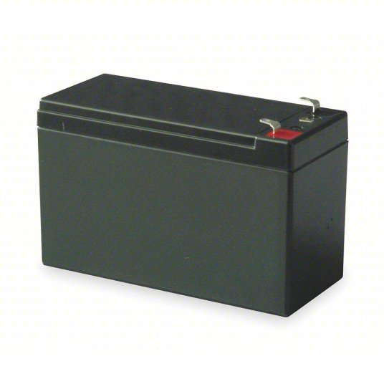
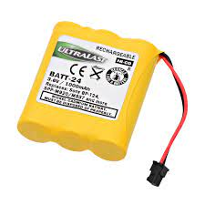
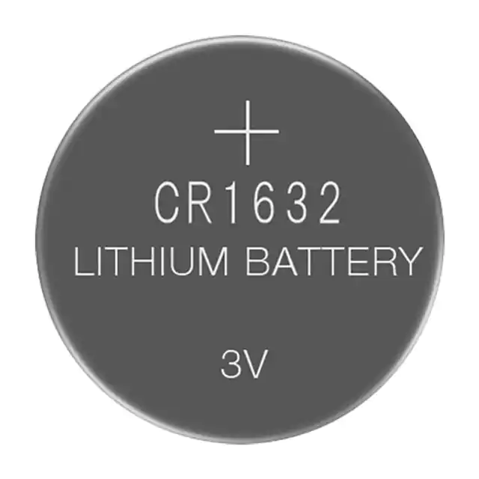
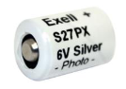
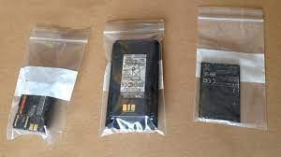
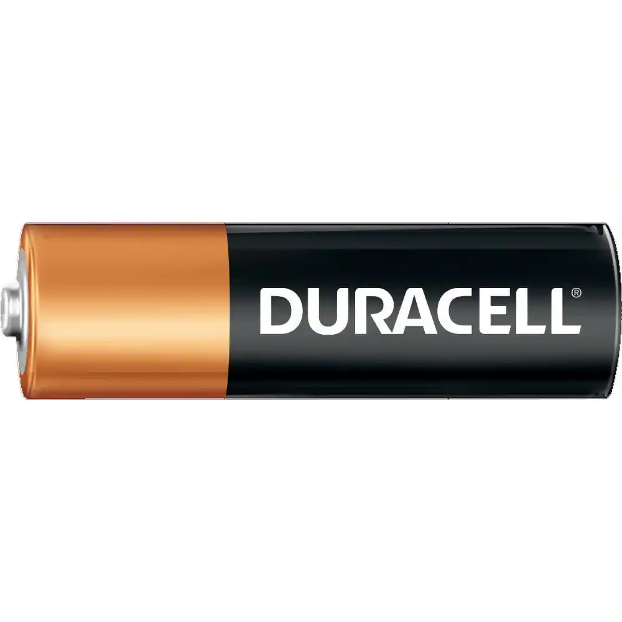
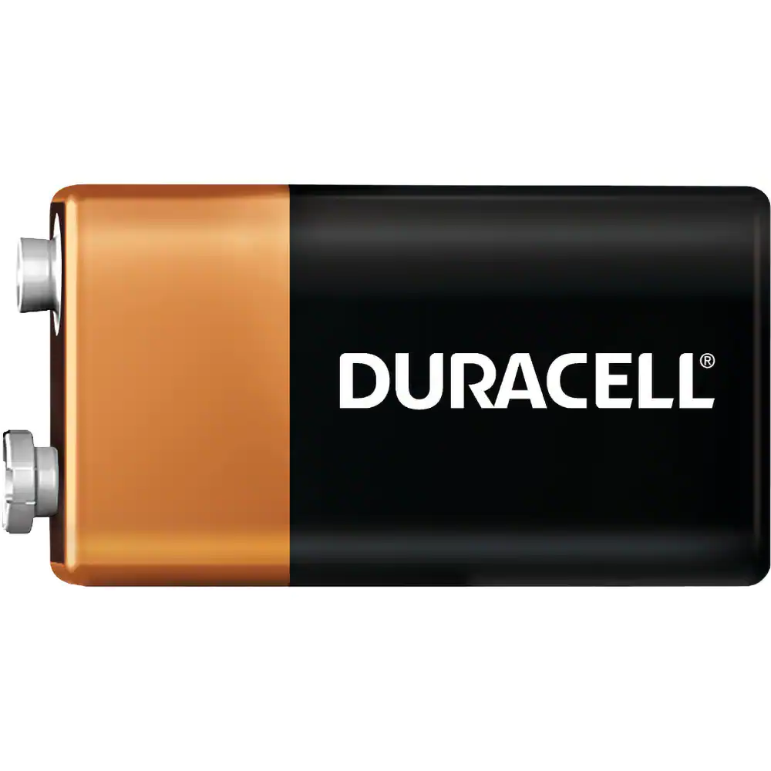
Universal Waste: Batteries
Batteries are generally labeled with the battery type or name and the following should be disposed of as universal waste.
  Lead Acid batteries (Pb-acid) are hazardous due to the lead content and corrosive nature of the acid inside the battery. Most commonly found in medical equipment, battery backup systems/UPS (Uninterruptible Power Supply) and in motorized vehicles such as automobiles or golf carts.
  Nickel Cadmium batteries (Ni-Cd) are hazardous due to their cadmium, a toxic heavy metal, content. Most commonly found in power tools and medical equipment. They are commonly wrapped or packaged together, but may also look similar to common alkaline batteries.
  Lithium batteries (Li-Ion) are hazardous and may react dangerously when handled or stored improperly. Most commonly used in electrical devices such as cell phones, laptops, power tools.
  Mercury and Silver batteries are considered hazardous for their heavy metal constituents. Most commonly found in watches, calculators, hearing aids and other small electronic devices.
Alkaline batteries are NOT managed as universal waste and may be disposed of in the regular trash. This includes AAA, AA, C, D and 9-volt.

Slide 17
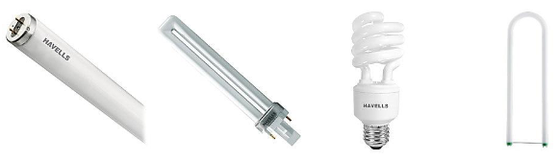
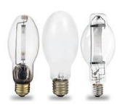
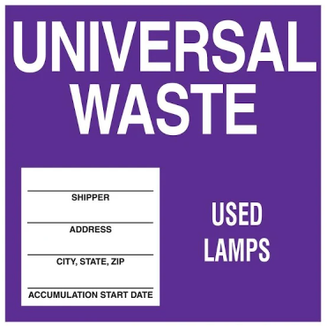
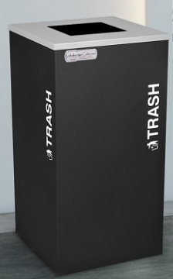
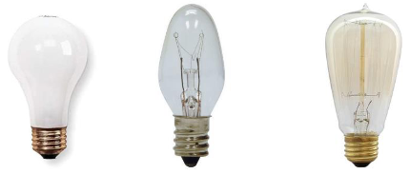
Universal Waste: Lamps
Light bulb styles containing mercury are managed by Facilities Services as universal waste, and include the following.
  Fluorescent: These are traditionally used in retail, commercial and educational buildings. These can come in many sizes and shapes, such as tubular, U-shaped, circular and compact fluorescent lights (CFL) which tend to be smaller units that may screw into fixtures.
  High Intensity Discharge (HID): These bulbs can be found in gymnasiums, large public areas, outdoor activity areas, roadways and parking lots. Includes high pressure sodium and metal halide.
  Ultraviolet (UV) Light Bulbs: Primarily used for disinfection.
Incandescent bulbs are primarily used for residential lighting. These traditional bulbs can be disposed of via common trash containers.

Slide 18
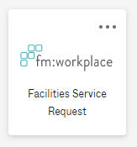
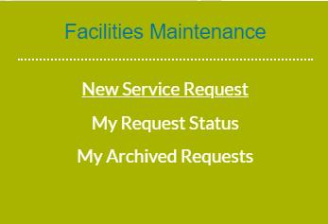
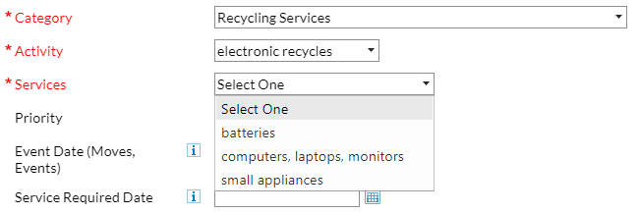
Electronic Waste (E-Waste)
Most electronic items (batteries, computers, small appliances, other equipment) can be picked up and recycled through Facilities Services.
Requests can be submitted through the Facilities Services Request app in mySLU under “Facilities Maintenance - New Service Request”, as shown below.

Slide 19
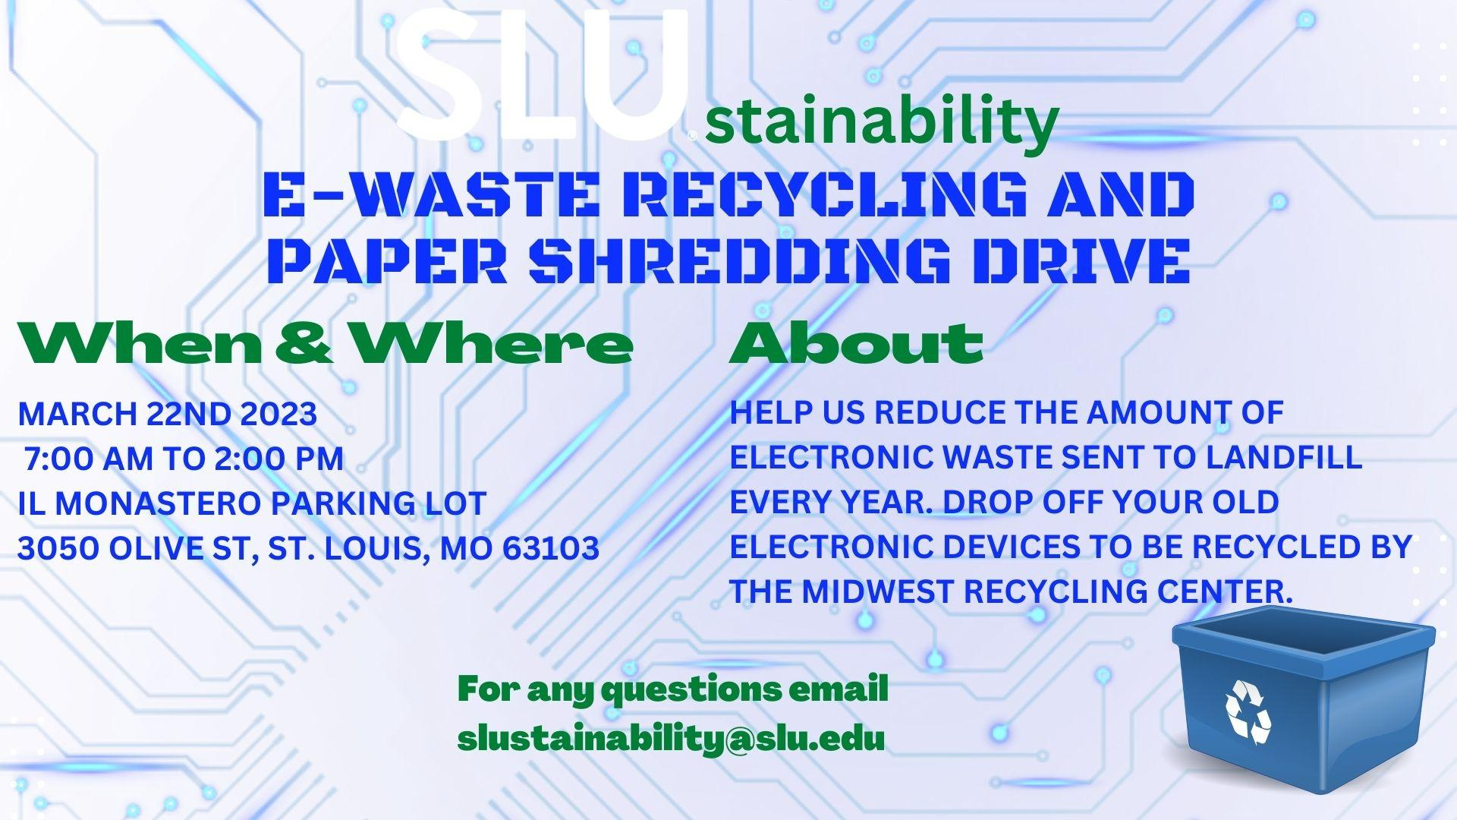

Slide 20
Summary
Contact information:
  Biological waste disposal: biowaste@slu.edu
  Chemical waste disposal: chemwaste@slu.edu
  Radiological waste disposal or General questions: ehs@slu.edu
Please complete the Safety Awareness Quiz on Waste by March 31, 2023.

