Slide 1
2023
Safety Awareness Review

Slide 2
Occupational Health Program (OHP)
Who needs to enroll in OHP?
Anyone working in SLU research labs or animal research facilities
Those enrolled in our Select Agent Program
Individuals working with Risk Group 3 recombinant materials
Individuals working with infectious or biohazardous materials, chemicals, radioactive materials, or physical hazards
Treatment for Work-Related Injury, Incident or Exposure:
ABSL-3/BSL-3 incidents and exposures
SSM Health SLU Emergency Dept.
Other work-related injuries
Concentra - during normal business hours, 8:00 AM - 5:00 PM
SSM Health SLU Emergency Dept. - after hours

Slide 3


Occupational Health Program
University Employee Health functions are no longer located in the SSM Health Saint Louis University Hospital Employee Health Office Location.
The Occupational Health Program and contracted medical vendor have replaced Employee Health
3100 Market Street
St. Louis, MO 63103
Phone (314) 421-2557
For additional information, refer to January PowerPoint slides.

Slide 4
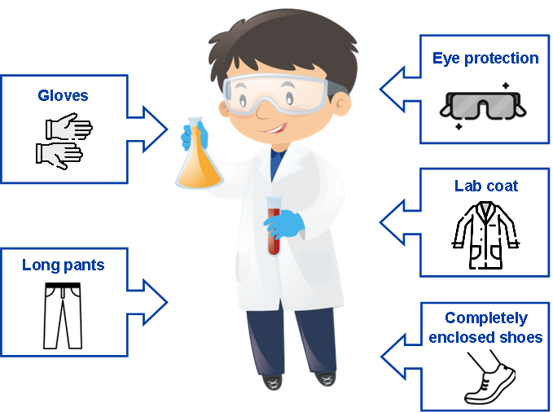
Personal Protective Equipment (PPE)
Know your hazards and choose PPE accordingly.
Note: Principal Investigators are responsible for providing PPE and ensuring appropriate use.
For additional information, refer to February PowerPoint slides.

Slide 5
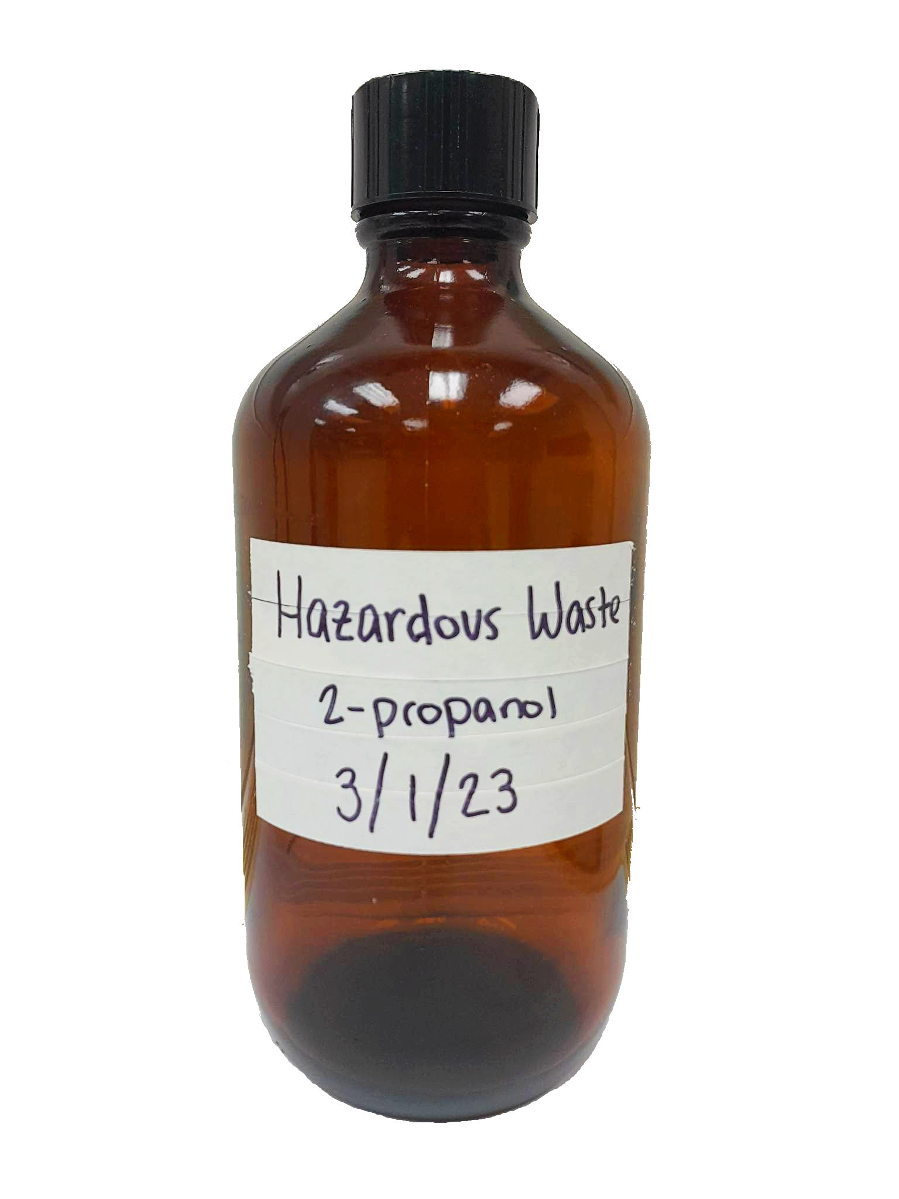
Laboratory Waste
Biohazardous Waste
Solid biohazardous waste can be autoclaved or placed into a Stericycle box.
Liquid biohazardous waste should be decontaminated using a 1:9 (10%) final bleach concentration.
Sharps Disposal
Sharps container ready for disposal must be closed and taped shut.
Place sharps container into a Stericycle box for pick-up.
For Stericycle box pick-up, complete the Biological Waste Removal Form or email biowaste@slu.edu.
Chemical Waste
All hazardous chemicals must be collected by EHS for proper disposal.
Chemical waste containers must be labeled with:
Hazardous Waste
All the chemical components
Start date of accumulation
Complete the Chemical Waste Removal Form when ready for pick-up.
For additional information, refer to March PowerPoint slides.

Slide 6
Laboratory Emergency Preparedness
Knowing what to do before an emergency occurs can make the difference between life and death or serious injury.
Severe Weather
Thunderstorm and Lightning
Floods
Winter Weather
Earthquakes
Fire
Medical Emergencies
Utility Outage
Active Shooter
Sharps Injury
Biohazardous/Chemical/Radioactive Spills
DPS: 314-977-3000
University closures: 314-977-SNOW (314-977-7669)
More information about campus emergency preparedness can be found here.
For additional information, refer to April PowerPoint slides.

Slide 7
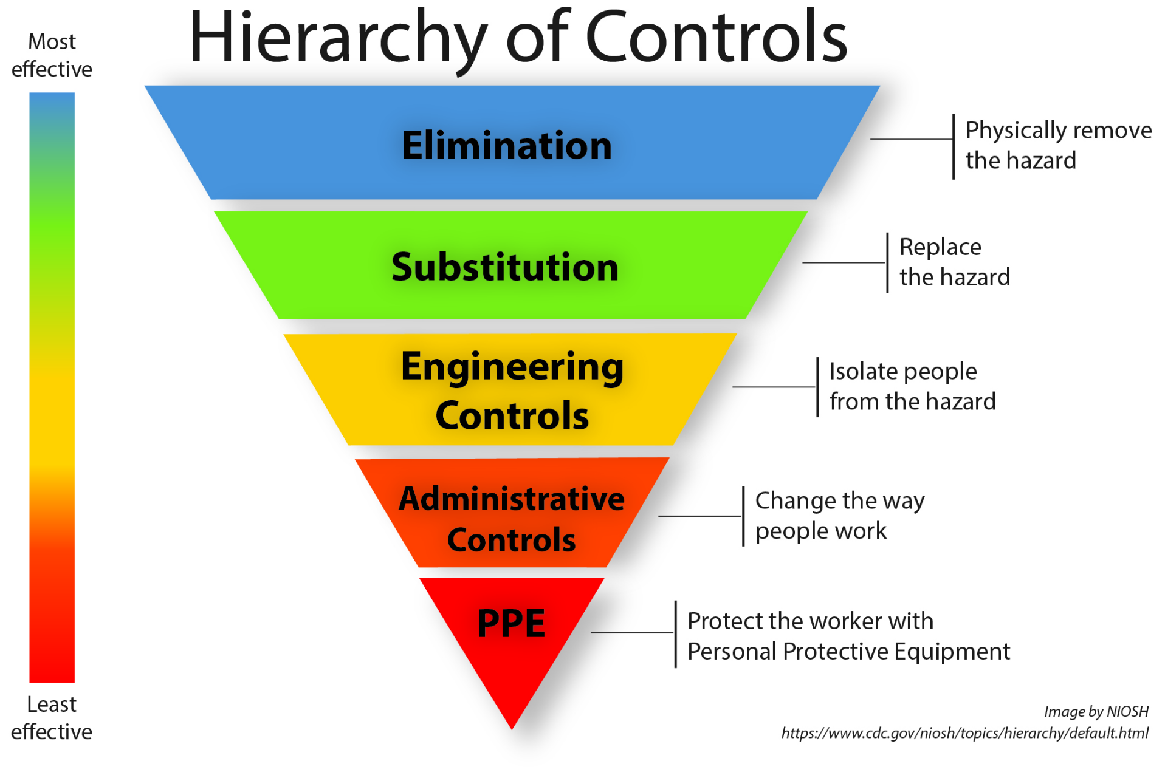
Engineering Controls
If a hazardous material cannot be eliminated or substituted, engineering controls are the first line of defense to isolate people from the hazard.
Chemical fume hoods
Biological Safety Cabinets
Centrifuge Rotors and Bucket Covers
Shielding for Radioactive Materials
Safety Needles
Vacuum Systems
Ergonomics
For additional information, refer to May PowerPoint slides.

Slide 8
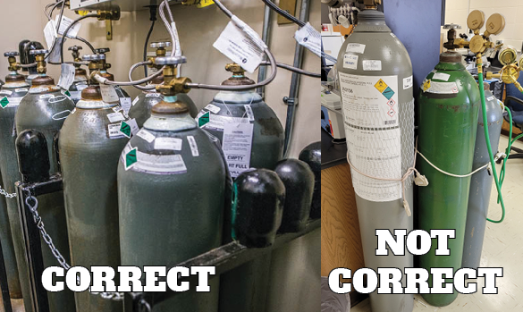
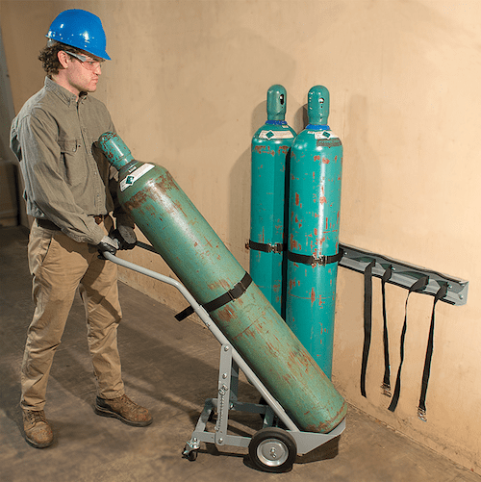
Liquids, Solids and Gases
Cryogenic Liquids and Dry Ice
Lab coats, safety glasses and cryogenically rated gloves should be worn.
Direct contact can cause severe burns.
Gas Cylinders
Should be stored upright in cool, dry, well ventilated spaces.
Must be secured with a chain or strap, even if empty.
Should be moved using a cylinder cart. Don’t roll cylinders by hand.
Kansas Fire Marshal on X
For additional information, refer to June PowerPoint slides.
https://www.justrite.com/news/gas-cylinder-safety-five-tips/

Slide 9
Radiation Safety Awareness
Radioactive materials may only be used:
Under the supervision of the Permit Holder who has been approved by the Radiation Safety Committee (RSC).
In RSC approved locations.
By personnel who have completed the Radiation Safety Orientation and passed the associated test.
Response to a Radioactive Material Spill:
If contaminated, restrict movement and do NOT leave the area.
Notify SLU DPS at 314-977-3000
For additional information, refer to July PowerPoint slides.

Slide 10
Training for Laboratory Personnel
The following trainings may be required for laboratory personnel:
Laboratory Safety & Compliance Training (LST)
Laboratory Specific Training
Lab-Specific Biosafety Training
Bloodborne Pathogen Awareness Training (BBP)
BSL-3 Facility Awareness Training
Animal Care Mandatory Training and Orientation (provided by CM)
Animal Biosafety Training (provided by CM)
Radiation Safety Orientation
Shippers Training (Biohazards, infectious agents, dry ice, etc.)
Only those with up-to-date training are allowed to work in the laboratory.
For additional information, refer to August PowerPoint slides.

Slide 11
Laboratory Inspections
Ensure a safe work environment for SLU employees, students and visitors
Identify hazards and areas of concern before incidents occur
Inspection | Relevant Laboratories | Frequency
Environmental Safety | All research and teaching laboratories. | Annually
Biological Safety | Labs using biological agents (BSL-2 agents or higher, recombinant or synthetic nucleic acid molecules (rsNA), or toxins). Any lab with an IBC protocol. | Annually
Radiation Safety | Laboratories approved for radioactive materials use. | Quarterly
For additional information, refer to September PowerPoint slides.

Slide 12
Health Exposures and Reporting
Chemical Hazards
Exposure to certain chemicals can cause acute and/or chronic health effects.
Biological Hazards
Laboratory acquired infections from lab specimens, blood, or other body fluids. (Most acquired via inhalation.)
Radiation Hazards
Radiation exposure can be reduced by using appropriate shielding and PPE, minimizing time working with radiation, and increasing distance from radioactive materials.
Physical Hazards
More likely to result in sudden injury and generally involve rapid release of energy (e.g., fire, explosive materials, compressed gases)
In the event of exposure to these hazards, contact Occupational Health Program Services:
Steven Cummings, MD
steven.cummings@health.slu.edu
Doisy Hall, R311
(314)977-7026
For additional information, refer to October PowerPoint slides.

Slide 13
General Safety
Hazard awareness helps you recognize potential hazards in your workplace and prevent injuries and illnesses.
Most Common Accidents at SLU for 2023:
Needle stick injuries
Falls
Lacerations
Strains
Prevention:
Use needle devices with safety features and utilize sharps containers.
Clean up spills immediately, wear slip-resistant shoes, utilize handrails, stay alert when walking, and report identified hazards.
Wear proper PPE and utilize safety equipment.
Lift objects using proper techniques.
For additional information, refer to November PowerPoint slides.

Slide 14
Minors in Labs Policy
Saint Louis University’s teaching and research mission includes a commitment to mentoring programs that educate youth who have scientific interests.
Minors may participate in shadowing, volunteer work in research laboratories, the STARS program, funded research projects, and tours of research facilities that may include demonstrations by SLU faculty.
Any faculty or research member requesting a minor’s participation in research, teaching or touring a lab facility must be approved by Environmental Health and Safety prior to entering or working in a laboratory.
All participating minors must complete Laboratory Safety & Compliance Training. Some minor participants may also be required to complete Bloodborne Pathogen Awareness Training.

Slide 15
Bring Your Dog To Work Policy
Dogs are prohibited from entering:
Any laboratory
Any buildings that house comparative medicine facilities
Fitness centers
Lactation rooms
Food preparation areas, serving and dining areas
Restrooms
Medical and patient care facilities
SLU vans or shuttles
Mechanical rooms
Kitchen areas
Data centers (located in Des Peres Hall, Doisy Research Center, and the Caroline Building)
Any such areas as designated by the building manager or Vice President of that division

Slide 16
Facilities Holiday Checklist
Facilities Management has put together a list of recommendations that will help conserve energy and will prevent unwanted surprises upon your return to the laboratory/office in January. Use this checklist to prepare for the break.
Offices Close and latch windows. Remove food or trash from the office Unplug miscellaneous equipment including radios, chargers, space heaters and power strips. Power down computers, copiers, and printers. Lower temperature set points or thermostat settings to achieve a temperature around 65 degrees. Turn off the lights. | Kitchens or Break Rooms Unplug coffee machines. Remove trash or food from the room. Empty and defrost break room refrigerators. Turn off the lights. Laboratories Ensure fume hood sashes are properly lowered. Deactivate unused equipment. Close or turn off the valves on unused gas cylinders. Ensure all tanks and gas cylinders are properly strapped and stored.

Slide 17
Summary
Thank you for participating in our Safety Awareness Campaign for 2023!
Contact ehs@slu.edu or steven.cummings@health.slu.edu with any questions.
Please complete the final Safety Awareness Quiz by December 31, 2023.

