Slide 1
Saint Louis University
General Safety

Slide 2
What is General Safety?
A multi-disciplinary approach to:
Developing and ensuring safe work practices
Maintaining the health and well-being of employees
Ensuring compliance with regulatory agencies.
EHS works to promote healthy and safe operations to protect all students, faculty, staff, and visitors.
Hazard awareness helps you recognize potential hazards in your workplace and is the key to preventing injuries and illnesses.

Slide 3
Common Accidents at SLU
Most common accidents for 2023:
Needle stick injuries
Falls
Lacerations
Strains
Prevention:
Wear proper PPE and utilize safety equipment
Keep workspaces clean and walkways clear
Lift objects using proper techniques

Slide 4
Common Laboratory Accidents
Laboratory Accident | Injury | Prevention
Spill or Splash | Eye injury, skin irritation, topical burn, inhalation of dangerous fumes, slip/fall, and impact injury. | Keep work area clean, follow procedures, avoid hasty movements, and wear appropriate PPE (e.g., safety glasses and lab coat).
Sharps Exposure | Skin puncture from needle, scalpel, or other sharp object. | Use needle devices with safety features and utilize sharps containers.
Slips, Trips, and Falls | Fracture, head injury, sprain, strain, back injury, and concussion. | Clean up spills immediately, wear slip-resistant shoes, utilize handrails, stay alert when walking, and report identified hazards.

Slide 5

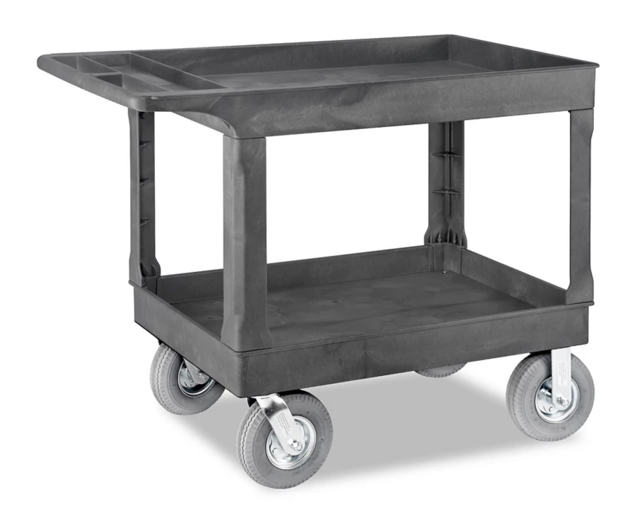
Slips, Trips, Falls
Second-most common cause of workplace injuries and 15% of all workplace deaths, according to OSHA.
Prevention:
Clean up spills immediately
Keep work areas free of clutter
Wear closed-toed, slip-resistant shoes
Keep walkways clear of obstructions and drawers closed
Use carts to transport heavy or bulky materials

Slide 6
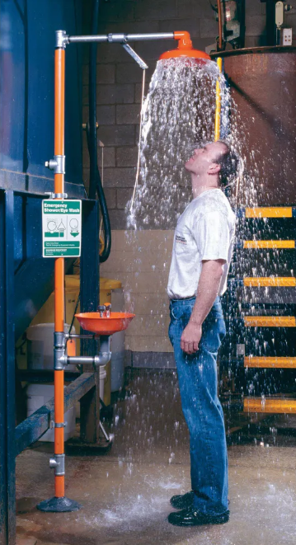
Safety Showers
Safety showers are tested annually by EHS.
The area around safety showers should be free from lab equipment and other obstructions.
Don’t be afraid to use it when needed!
imperialsupplies.com/item/9122233

Slide 7
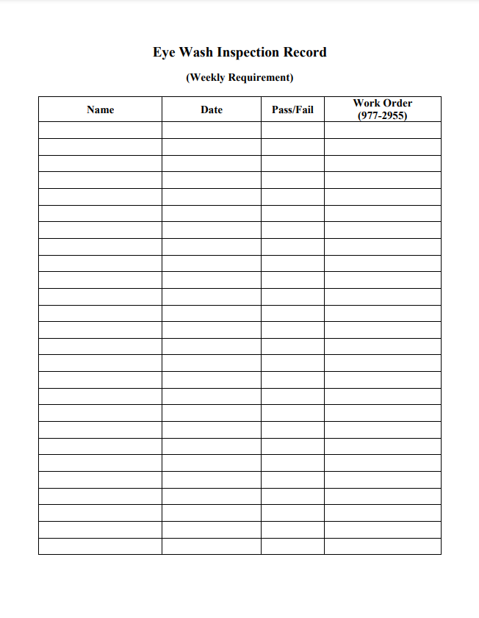
Eye Washes
Eye washes inside the laboratory must be flushed weekly by lab personnel to ensure proper function.
Eye wash/safety shower combinations in common areas are tested by EHS.
The area around eye washes should be free from lab equipment and other obstructions.

Slide 8
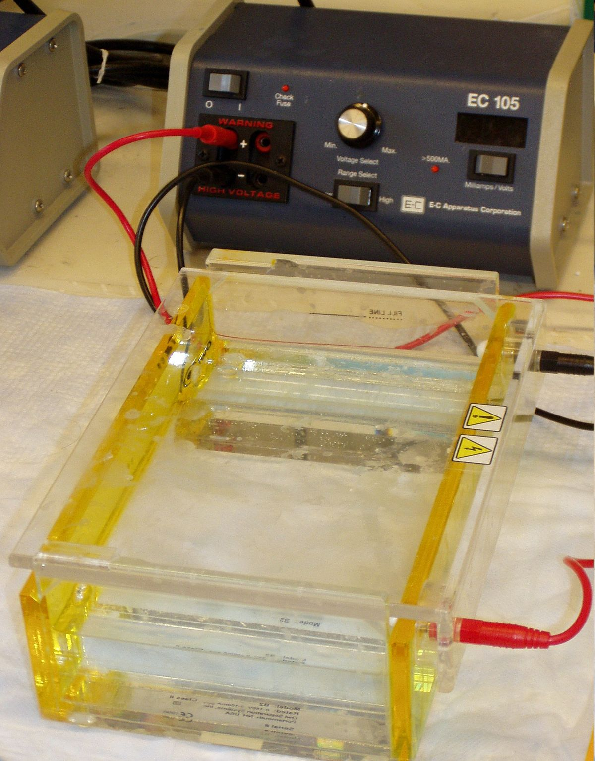
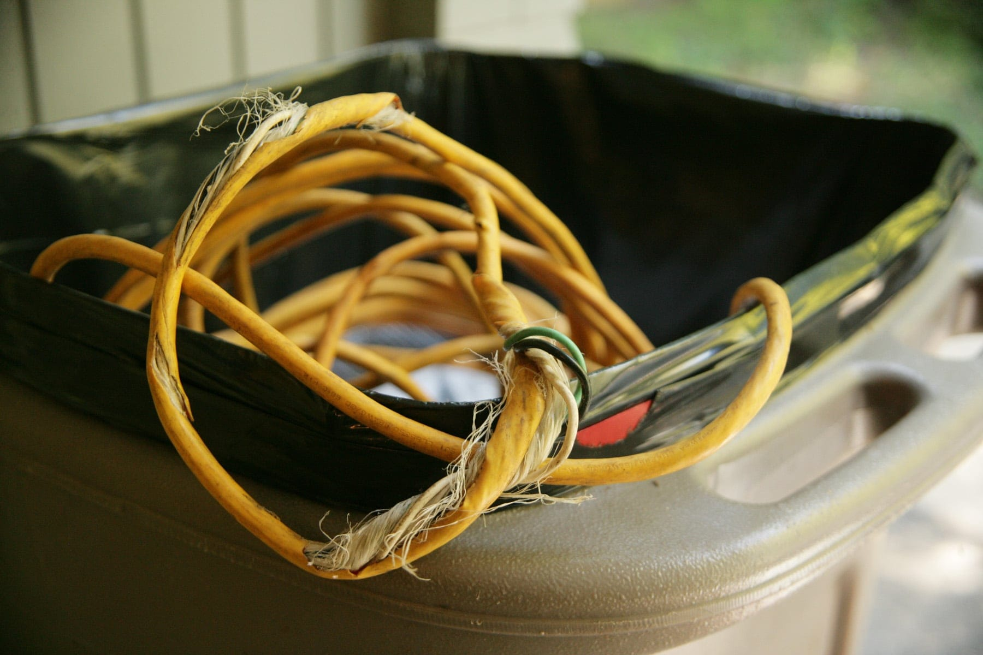
Electrical Safety
Lab equipment and other electrical items should be inspected regularly for damaged or frayed cords.
Gel Electrophoresis
https://en.wikipedia.org/wiki/File:Gel_electrophoresis_apparatus.JPG

Slide 9
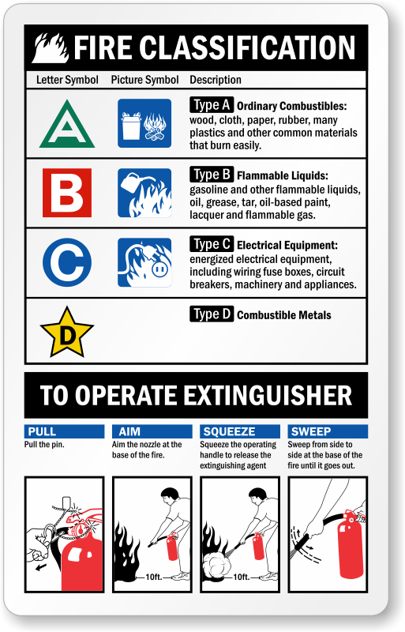
Fire Safety and Evacuation
Know the locations of nearby fire extinguishers and know how to operate them.
Know your location’s emergency evacuation plan and assembly area.
Fire extinguishers are classified by fire type.

Slide 10
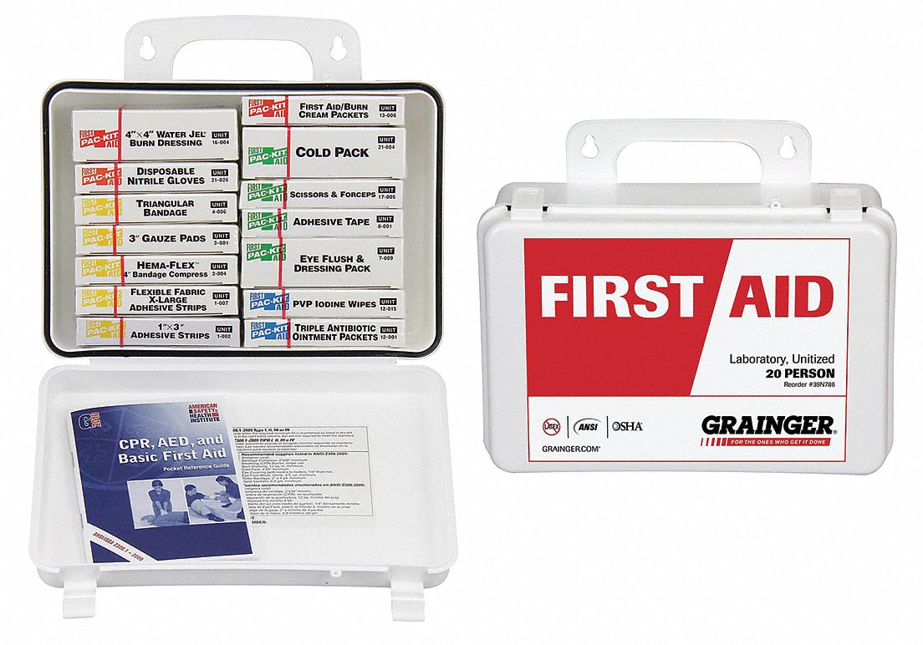
First Aid Basics
DPS offers Basic Life Support Classes (CPR/AED/First Aid)
  Classes are held on an as needed basis.
  For additional information, please contact Officer Marble at brian.marble@slu.edu.
First aid kits required in laboratories
  Lab personnel should be aware of the location of the first aid kit.
  Laboratories are responsible for purchasing first aid kits.
https://www.grainger.com/product/GRAINGER-APPROVED-First-Aid-Kit-Laboratory-39N786

Slide 11
Fatigue and Stress Management
Signs and symptoms of workplace fatigue:
Feeling tired, weary or sleepy
Difficulty keeping eyes open
Feeling physically or mentally exhausted
Difficulty concentrating, impaired focus
Increased errors in judgement, flawed logic
Emotional instability or irritability
Prevention:
Report any fatigue-related events to a manager.
Check in with co-workers to ensure everyone is coping with work hours and demands.
Do not work if stressful feelings/fatigue threaten the safety of yourself or others.
Avoid working alone (late nights and weekends).

Slide 12
Summary
Contact ehs@slu.edu with any questions.
Please complete the Safety Awareness Quiz on General Safety by November 30th, 2023.

