Slide 1

Saint Louis University
Occupational Health Program for
Laboratory and Animal Research

Slide 2
Slide Deck Outline
Provide education on the new Occupational Health Program (OHP)
What is the OHP?
Employee Health Program changes
Where do I go to get a vaccine?
Where do I go if I get injured?
How do I get a copy of my records?

Slide 3
Occupational Health Program (OHP)
Helps maintain a safe and healthy research environment
Prevents occupational injury and illness

Slide 4

Who Needs to Enroll in OHP?
Anyone working in SLU research laboratories or animal research facilities
  The level of OHP participation is based on risk assessment of hazards posed by their assigned duties and setting
Those enrolled in our Select Agent Program
  Required under the Select Agent Rule (42 CFR 73)
Individuals working with Risk Group 3 recombinant materials
Individuals working with:
  Infectious or biohazardous materials
  Chemicals
  Radioactive materials
  Physical hazards

Slide 5
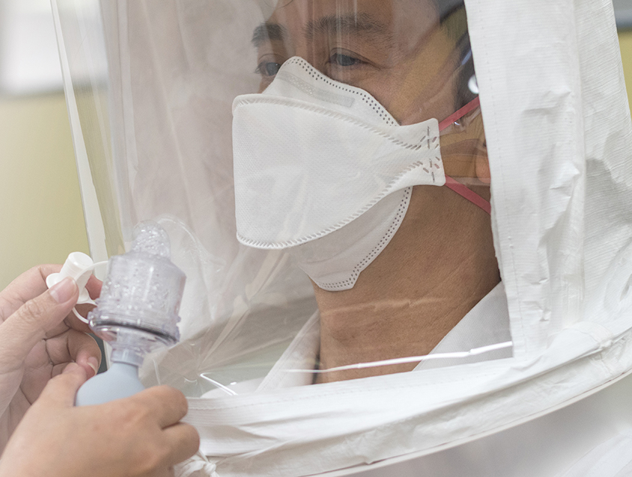
OHP Services for Laboratory and Animal Research
Medical clearance
Vaccination review
Respirator fit testing
Confidential assistance for:
  Laboratory animal allergies
  Pregnancy
  Immunocompromised individuals

Slide 6

Work Specific Vaccinations
Work-specific vaccination requirements are specified for each Institutional Biosafety Committee (IBC) protocol
    IBC protocol page 3, section 9
The Principal Investigator (PI) is responsible for ensuring that their personnel are compliant with specific vaccination requirements
Consult with the OHP manager
    OHP manager will refer personnel to appropriate vaccine provider
      eg - Concentra Urgent Care

Slide 7

University Employee Health functions are no longer located in the SSM Health Saint Louis University Hospital Employee Health Office Location!
The Occupational Health Program and contracted medical vendor have replaced Employee Health
Pay careful attention to the changes highlighted on the following slides

Slide 8
Work-Related Injury, Incident or Exposure
Report to supervisor
Complete Employee Report
  www.slu.edu/facilities/risk-management-insurance/employeereportofinjuryuniv2022.pdf
Seek treatment:
    ABSL-3/BSL-3 Incidents and Exposures
      SSM Health Saint Louis University Hospital Emergency Dept.
    Other Work-Related Injuries
      Concentra – 3100 Market Street; phone 314-421-2557
        during normal business hours, 8:00 AM- 5:00 PM
      SSM Health Saint Louis University Hospital Emergency Dept.
        after hours

Slide 9

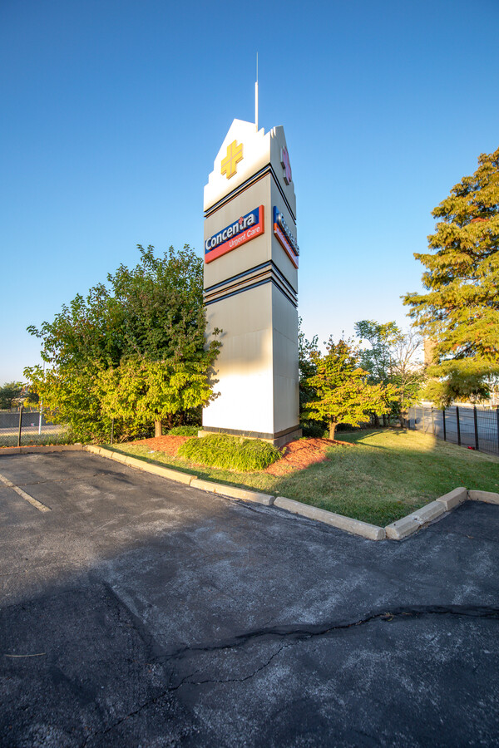
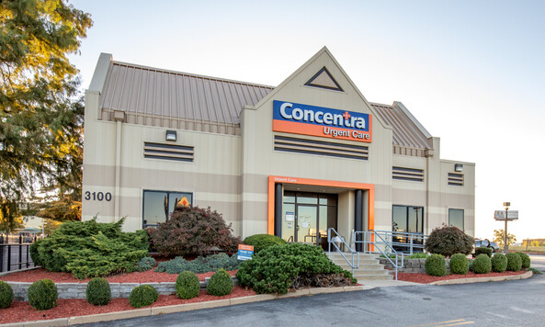
For Work Related Illnesses or Injuries and Vaccinations
3100 Market Street
St. Louis, MO 63103
Phone (314) 421-2557
Note: After 5 PM, seek care at SSM Health Saint Louis University Hospital Emergency Department

Slide 10
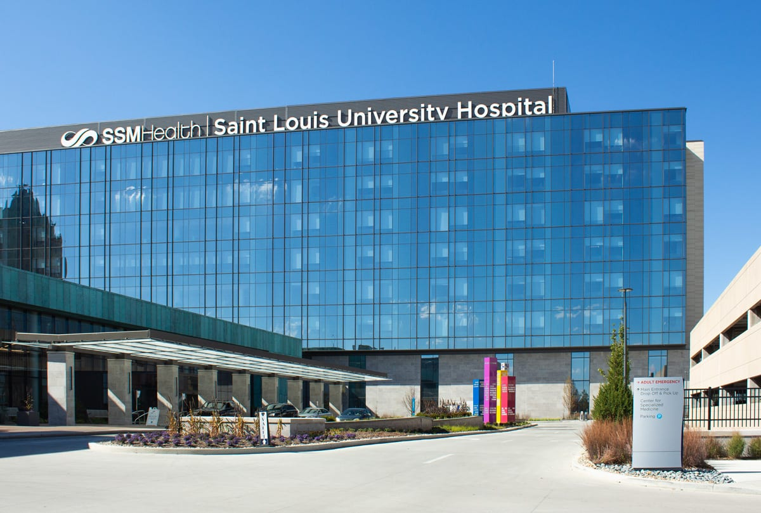
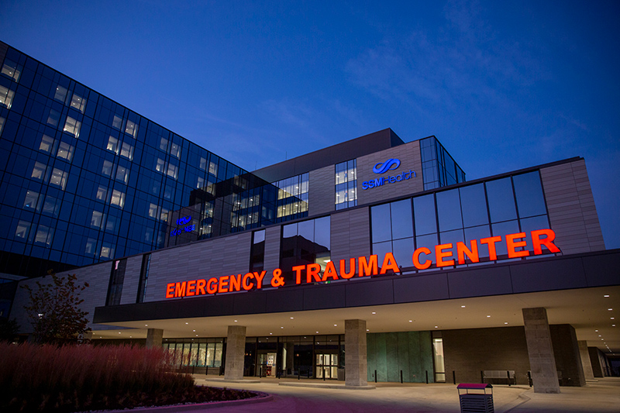
ABSL-3/BSL-3 Incidents and After Hour Exposures
SSM Health Saint Louis University Hospital
Emergency Department
1201 South Grand Boulevard
St. Louis, MO 63110
Phone (314) 257-1320

Slide 11
Employee Records
You have a right to access your employee exposure and employee medical records.
How do I obtain a copy of my employee medical records?
    Provide a written request to Saint Louis University Risk Management
How do I obtain a copy of my radiation dosimetry records?
    Provide a written request to Saint Louis University Environmental Health and Safety
More information is available at the following link: https://www.slu.edu/research/faculty-resources/docs/slu-osha-notice-to-employees.pdf

Slide 12
Occupational Health Program Contact Information
Occupational Health Program Manager
Steven Cummings, MD
  steven.cummings@health.slu.edu
  Doisy Hall, R311
  314-977-7026
Please Note: The OHP office is staffed part time and does not provide injury care.

Slide 13
Important Information
  Note that these slides are specific to personnel (including students) working in research laboratories or animal facilities.
  Students injured in teaching labs as part of their coursework should report to Student Health or SSM Health Saint Louis University Hospital for emergencies or after hour care.

