Slide 1
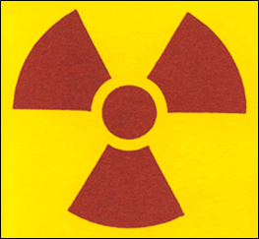
Saint Louis University
Radiation Safety Awareness

Slide 2
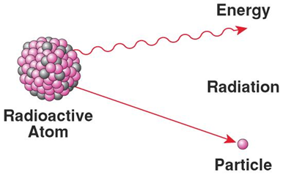
What is Radioactivity?
Radioactivity is the spontaneous emission of particles or rays from unstable atoms.
Radioactivity can be found in natural sources such as air, soil, the sun, or from man made sources such as the radionuclides used for medical procedures and research.

Slide 3
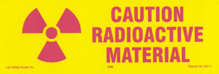
Radioactive Materials Use
Radioactive materials may only be used:
Under the supervision of a Permit Holder who has been approved by the Radiation Safety Committee (RSC).
In RSC approved locations.
By personnel who have completed the Radiation Safety Orientation and passed the associated test.
For more information visit: SLU Radiation Safety

Slide 4
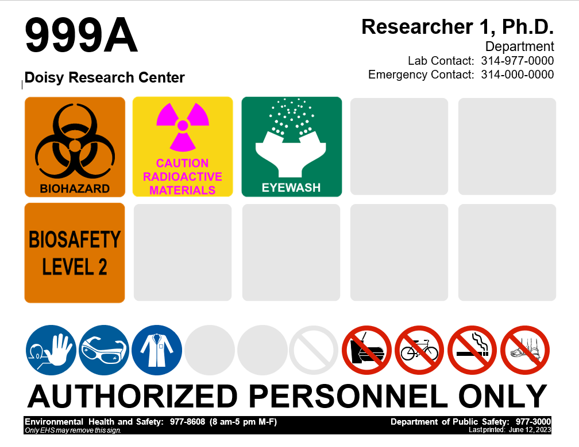
Recognizing the Presence of Radioactive Materials
Restricted Areas
A “restricted area” is any area where radioactive materials are used or stored.
These areas can be recognized by the red or magenta on yellow “Caution Radioactive Material” sign, which includes the international radiation symbol.
These signs may be various shapes and sizes. The most common format in use at Saint Louis University is shown below.

Slide 5
Recognizing the Presence of Radioactive Materials
Restricted Areas (continued)
You should not be afraid to enter such a restricted area, but you must be respectful of the presence of radioactive material.
When used safely and with appropriate training, authorized personnel generally incur no measurable dose.
Personnel entering these areas should be knowledgeable that they are entering a restricted area and should take appropriate precautions.

Slide 6
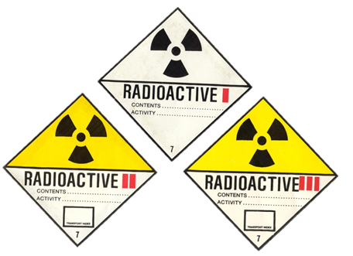
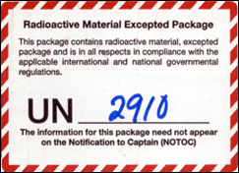
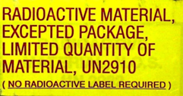
Recognizing the Presence of Radioactive Materials
Boxes Used to Ship Radioactive Materials
Examples of common labels on shipping boxes used for radioactive materials are shown below.

Slide 7
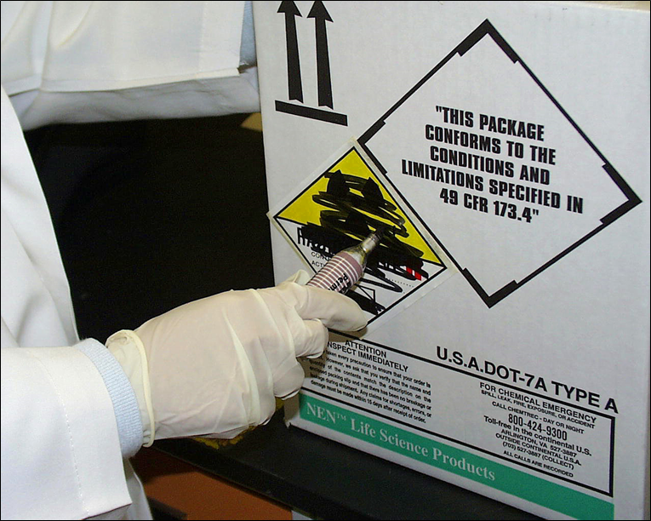
Recognizing the Presence of Radioactive Materials
Boxes Used to Ship Radioactive Materials
Containers used to ship radioactive materials must be tested and verified to be free of radioactivity prior to disposal in the regular trash.
To show that this has been done, the federal government requires that radioactive materials labels be removed or marked through (as shown below) prior to disposal in the regular trash.

Slide 8
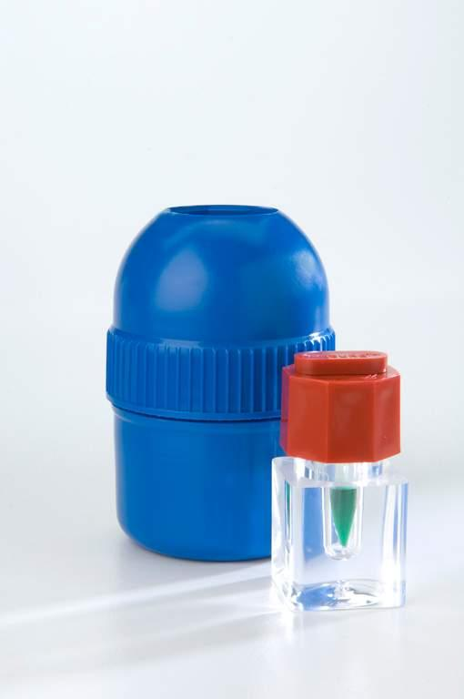
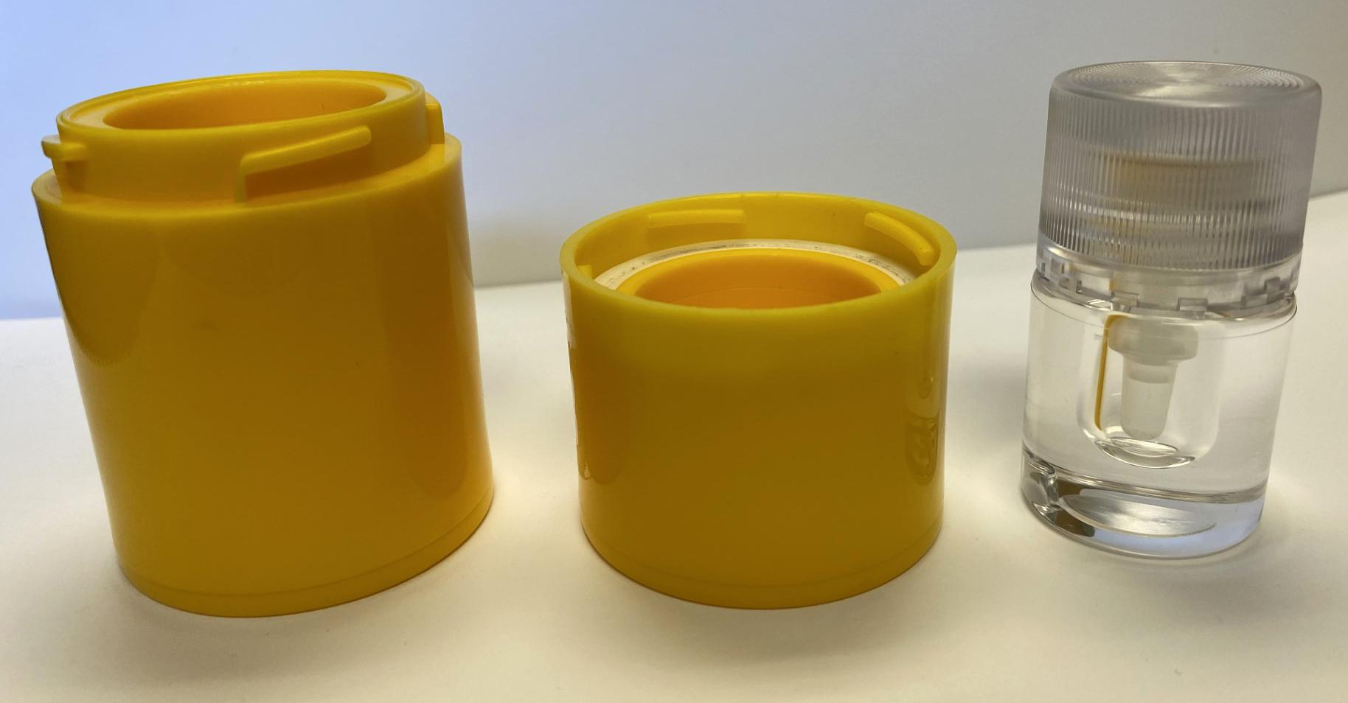
Recognizing the Presence of Radioactive Materials
Radioactive Materials Appearance
The innermost container that the radioactivity comes in is known as the stock vial. Examples are shown below.
The material inside the stock vial is usually a clear liquid.
This material cannot be easily seen when spilled, and can
easily spread. It is concentrated, so a little can go a long way!
Perkin-Elmer

Slide 9
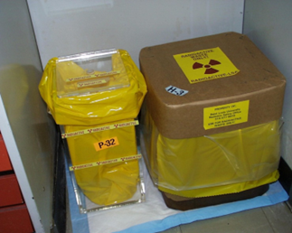
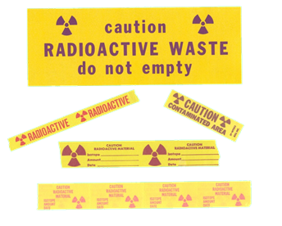
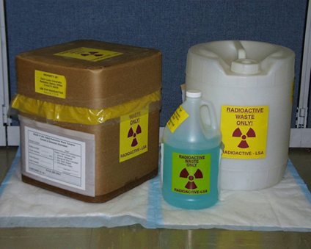
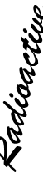
Recognizing the Presence of Radioactive Materials
Radioactive Waste Containers
Radioactive waste at SLU is typically stored in standard containers like the ones shown below.
Some labs may store waste in non-standard containers. These containers must have labels which are red or magenta on yellow.
Sometimes, the word “Radioactive” may be written on a waste container with a marker, even though this does not comply with the NRC regulations.

Slide 10
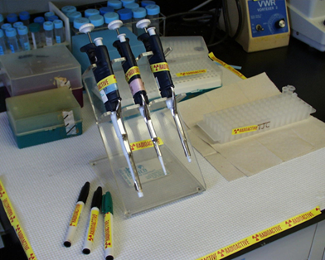
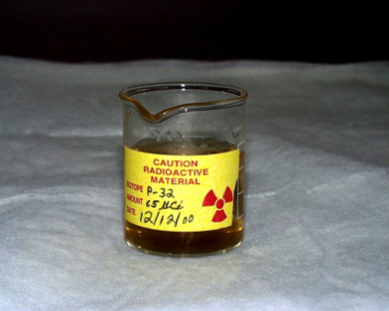
Recognizing the Presence of Radioactive Materials
Radioactive Lab Areas and Equipment
Lab areas and equipment used for radioactive materials are identified using specific labels and tape.
There are different sizes and shapes of these labels. These labels should always be red or magenta on yellow (as shown below).

Slide 11
Precautions to Take When in Restricted Areas
Avoid touching any container, box, trash can, etc. labeled with the words “Radioactive” or “Radioactive Materials” (even if only hand-written).
Do not touch any of the bench tops in the designated radioactive areas, or any equipment in those areas.

Slide 12
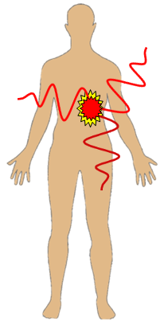
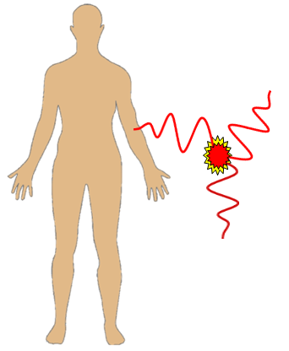
Types of Radiation Dose
Internal Dose
An internal dose of radiation is received when an individual is exposed to radiation internally.
Radioactive materials may be ingested, inhaled, or absorbed through the skin.
External Dose
An external dose of radiation is received when an individual is exposed to radiation outside of the body.
Standing in close proximity to an unshielded stock vial of P-32 for an extended period of time will result in an external dose of radiation.

Slide 13
Internal Dose
Internal exposure is irradiation of body tissues by a radioactive material deposited within the body.
This can occur only if the individual has ingested, inhaled, or by some other route absorbed some radioactive material into the body.
In research labs, the most likely cause is poor lab hygiene.
Poor lab hygiene can result in radioactive contamination being transferred to an individual’s hands and from hands to mouth possibly via a pen or pencil, eating or drinking, etc.

Slide 14
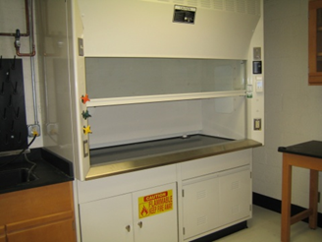
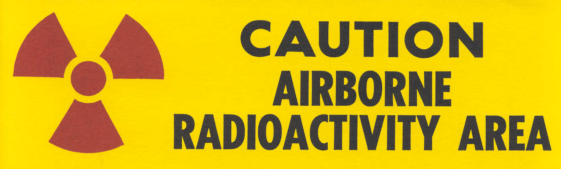

Internal Dose - Inhalation
Fortunately, few radionuclides at SLU evaporate readily into the air.
These materials are required to be used in fume hoods that are routinely measured and approved by Radiation Safety staff.
Each of these hoods is required to be posted with the sign shown below:

Slide 15
External Dose
External exposure is irradiation of tissue from a source of radiation outside the body.
External exposure occurs when radioactive material is in close proximity to the body or in contact with it.
There are a few exceptions to this (e.g., H-3 and C-14 which are too weak to penetrate the dead layer of skin).
For stronger, more energetic radiation sources, exposure can occur when the source is several feet away.

Slide 16
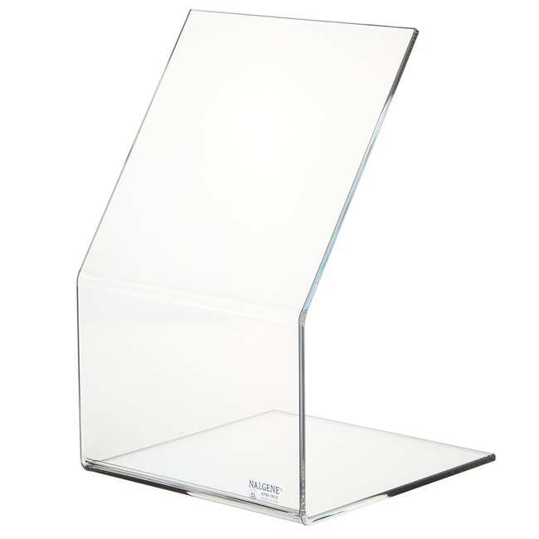
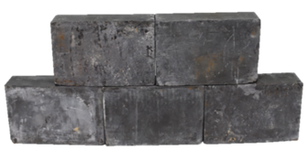
External Dose (continued)
In most restricted areas (e.g., research labs) at our institution, the radioactive materials do not cause significant exposure at distances of a few feet away.
In those cases where significant exposure is detected, shielding is employed to store the materials safely (lead for x-rays and gamma rays, Plexiglas or plastic for strong/energetic beta emitters).

Slide 17




Eating, Drinking, Etc. in Restricted Areas
No eating, drinking, smoking, or application of cosmetics or contact lenses is allowed in any laboratory where biological, chemical, or radioactive materials may be present.
Food and drink may not be stored in any laboratory in which hazardous chemicals are used (applies to cold rooms, freezer rooms, refrigerators, etc.)
No research oven or microwave shall be used for heating or cooking of any food or beverage.

Slide 18
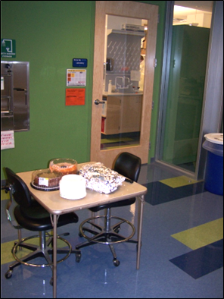
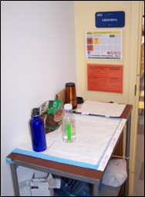
Eating, Drinking, Etc. in Restricted Areas (continued)
Eating and drinking is permitted in unrestricted areas where no hazardous materials are used or stored.
Clean areas can only be set up in areas that have a physical barrier (such as a door) between the restricted and unrestricted areas.
Examples:
Lunch Rooms & Break Rooms
Cafeterias
Offices

Slide 19
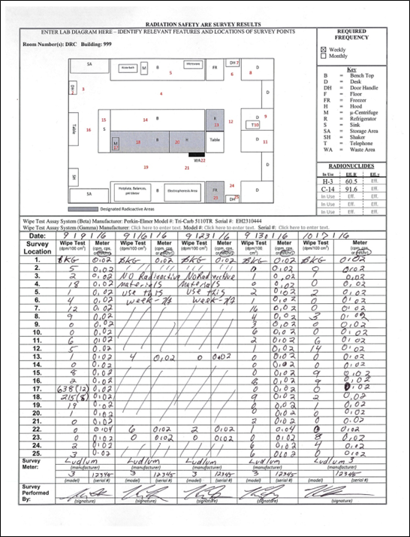
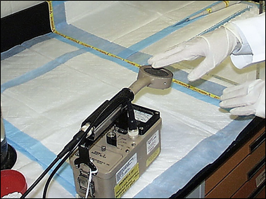
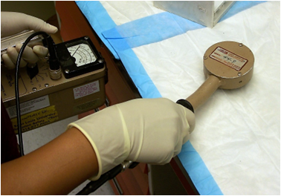
Elements for Control of Contamination
Contamination surveys are done during and after each experiment involving radioactive materials.
Laboratory-wide contamination surveys are documented weekly.
Both survey meter readings and wipe tests are required (unless only H-3 is being used/stored in which case only wipe tests are required).

Slide 20
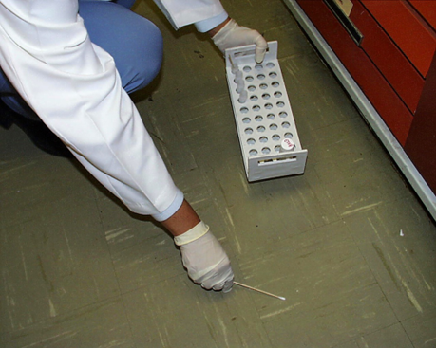
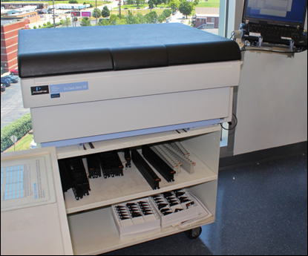
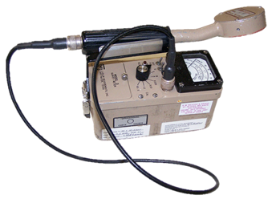
Survey Instruments
A survey meter is required to be on the bench and turned on when radioactive materials are in use.
The meter/detector should be appropriate for the type of radiation in use.
Wipe tests are assayed on a liquid scintillation counter.

Slide 21
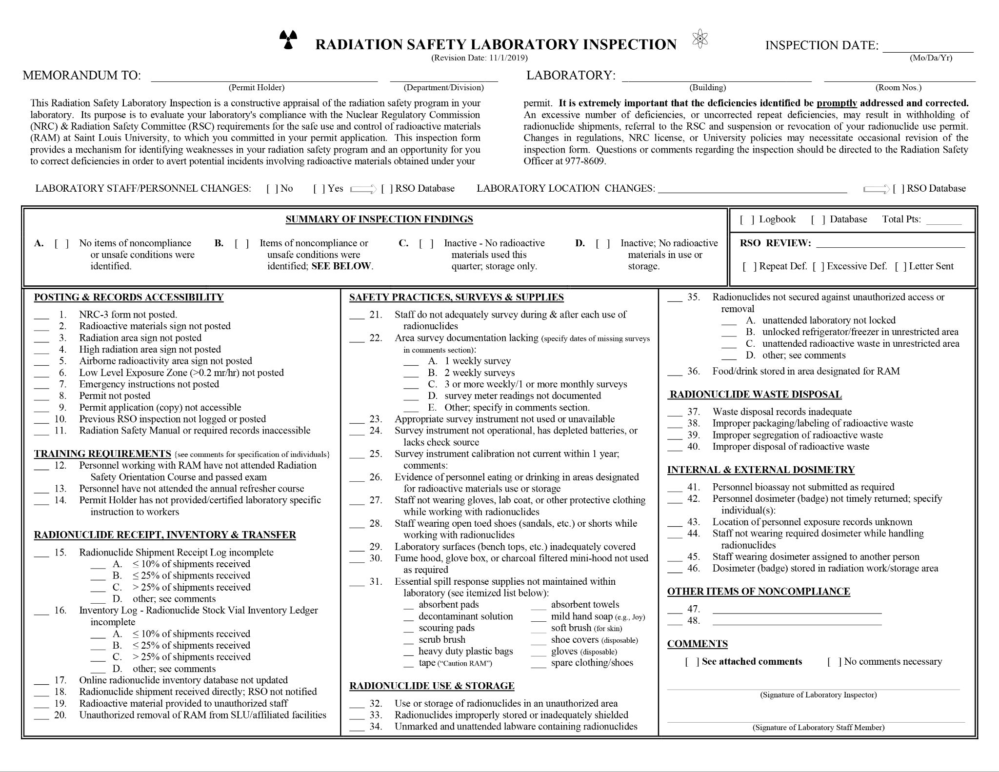
Laboratory Inspections
Radiation Safety staff inspect labs quarterly, including contamination survey records.

Slide 22
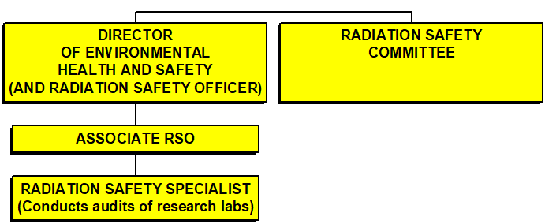

Laboratory Inspections (continued)
Any significant safety or compliance issues are reported to the SLU Radiation Safety Committee (RSC) and the Administration of Saint Louis University.
The Radiation Safety Officer (RSO) has the authority to shut the lab down if it is deemed necessary.

Slide 23
Laboratory Decommissioning
Contact the Associate Radiation Safety Officer as soon as a laboratory move is known. (NOTE: Do NOT dispose of ANY past Lab Radiation Safety Records**.)
This needs to be done prior to terminating your Radioactive Materials Permit and/or well in advance of the PI relocating to another laboratory with the University or leaving the University.
Prior to a relocation within the University, termination of your radioactive materials permit, and/or relocating to another institution, all applicable steps below must be completed.
Prior to moving to another location within the University, complete and submit an “Application for Approved Location Change”.
Transfer radioactive materials (excluding waste) to another SLU Permit Holder.
Must be done through the SLU Radiation Safety Office.
The transferee permit holder must be approved in advance for the radionuclides(s) and activities to be transferred.
If the radioactive materials must be moved elsewhere on campus by vehicle, contact Radiation Safety staff to perform this transfer for you.
Radioactive materials are not generally allowed to be transferred to another institution except under unusual circumstances.
Dispose of all radioactive waste prior to the move.
Pack all waste properly and request a radioactive waste pick up.

Slide 24
Laboratory Decommissioning (continued)
Complete thorough contamination surveys of all laboratory surfaces and equipment that has been used in conjunction with radioactive materials.
Both wipe tests and meter surveys are required. Only wipe tests are required for H-3 (tritium).
Decontaminate any laboratory surfaces and equipment surfaces found to be contaminated.
Document all wipe test and meter survey results, decontamination efforts, and follow-up wipe tests and meter survey results demonstrating successful decontamination.
Remove “Radioactive Materials” labels, etc.
Remove radioactive materials labels, stickers and tape from laboratory surfaces, equipment, instruments, and other items confirmed to be free of radioactive contamination after completing no. 4 above.
Do NOT remove postings on the doors or rooms.
Contact Radiation Safety Staff to arrange for decommissioning confirmatory surveys.
**Retention/transfer of radiation safety records will also be discussed.

Slide 25

Response to a Spilled Container of Radioactive Material
In the event that there is a spill of radioactive material stay out of the area, and notify the Saint Louis University Department of Public Safety immediately at:
314-977-3000
The dispatcher will notify the appropriate response team. This procedure applies 24 hours a day, 7 days a week.
If a water leak or other leak develops in any area, always assume that it is contaminated (chemically or radioactively) until the source and pathway of the leak has been determined, and it is confirmed to not contain radioactive or other hazardous materials.

Slide 26
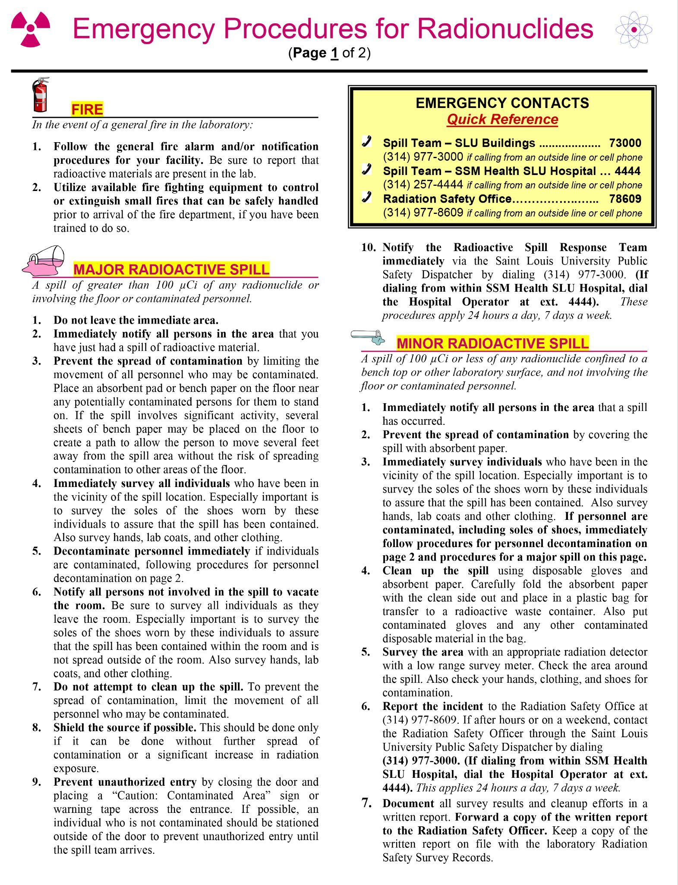
Radioactive Spills (continued)
If you accidentally walk through an area that is believed to be contaminated with radioactive materials, take the following precautions:
Do not leave the area!
Remain at the scene and keep movement within the area to a minimum!
Wait to be tested (surveyed) by a qualified spill team member.
Leave the area only after you have been surveyed and are told by a qualified spill team member that you may leave the area.
More detailed instructions are posted in labs authorized for radioactive materials.

Slide 27
Summary
Please complete the Safety Awareness Quiz on Radiation Safety by July 31, 2023.
Please contact ehs@slu.edu for any questions.

