Slide 1

Business Manager Meeting
  June 10, 2021

Slide 2
Announcements
Future Business Manager Meetings
  Submit topics of interest to budgetoffice@slu.edu
  September 9, 2021

Slide 3
Hiring & I-9 Requirement Reminders
June Business Manager’s Meeting

Slide 4
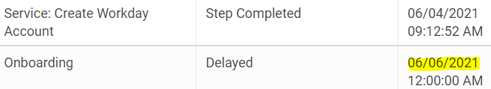
I-9 Compliance Reminders/Hire Process
General Process
  Employee should be notified of the I-9 requirement during the offer
  Hire should be entered in Workday at least 2 weeks prior to the intended hire date
  Automated I-9 Onboarding message generates from Workday two days after the hire is FULLY approved
  HR reaches out to set up the in person I-9 appointment by the third day of employment
  Employees will receive a certificate showing they completed the I-9 and managers should not allow people to work if they do not show the certificate.

Slide 5
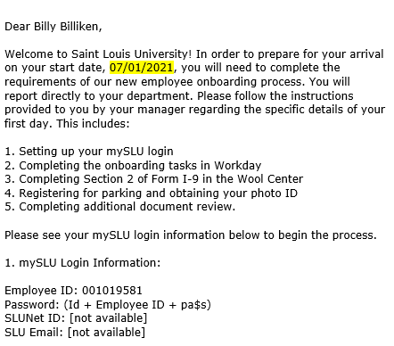
I-9 Compliance Reminders
Correct Hire Dates
  Please be sure the hire date is the first working day for the employee. For GA’s, the hire does not have to be the first day of the month. They will still be paid their full month stipend based on the Period Activity Pay task.
Remote Hires
  You need to work with your recruiter or contact HR@slu.edu before hiring a remote employee
  Student workers cannot work remote outside of IL or MO

Slide 6
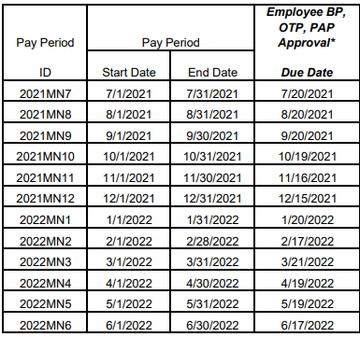
Payroll Deadlines in FY22
Payroll transaction deadlines have changed for FY22 to allow submitters more time to enter payroll-impacting transactions (OTP, Comp Changes, Job Changes, Period Activity Pay, etc)
These will be firm deadlines in the new fiscal year

Slide 7
Graduation Reminder - Student Workers
Student Workers that graduated in May may not continue to work as Student Workers.
If a graduated student is continuing to work this summer, they must be moved into a different role by May 21, 2021.
We recommend checking in with your entire student worker population to determine their plans for the fall and enter any terminations or leaves as needed.

Slide 8
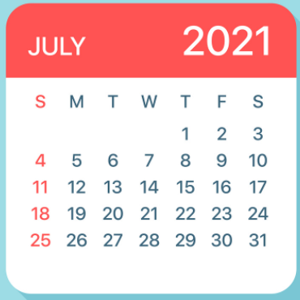
Full-Time Benefit Eligible Hire Dates
Please keep benefits in mind when choosing a hire date. Employees are responsible for paying for benefits for the entire pay period.
SLU does not prorate benefits if employees start later in the pay period
Ex. An exempt (salaried) employee with a 6/28 (Monday) hire date is going to have to pay premiums for the entire month of June.

Slide 9

Student Worker/ FWS Hires
HR has updated the job aid for Student Workers.
For each scenario, please visit:
New Hire: Page 4
Re-hire: Page 4
Add Job: Page 5
Please make a unique Business Title and Job Title:
Student Worker - “Department” - “TA, Admin, etc”
*Only use the position specific if employee is holding multiple positions within the department.

Slide 10
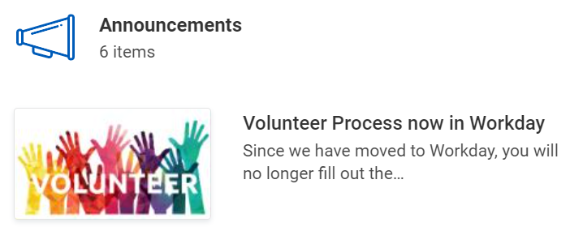
Volunteer Reminders
No longer using paper volunteer form, need to enter in Workday
Create position for volunteer
Complete Contract Contingent Worker business process
HR will initiate CBC & drug screen for volunteers as needed
Business managers will need to send out onboarding email with SLU login credentials
Notes:
Template for onboarding email:
Good afternoon,
1. Please see your mySLU login information below to begin the process.
mySLU Login Information:
Employee ID:
Temporary Password: (Id + last 6 digits of Employee ID)
SLUNet ID:
SLU Email:
Setup Multifactor Authentication and change your initial password by going: https://auth.slu.edu/ .Instructions can be found at: https://drive.google.com/file/d/12tWaL5VMpSw17bKx4B_5ioMiH8tEOgW1/view
The final step is to complete SecureAuth registration. This can be done by clicking on the following link: https://login2.slu.edu/ For additional assistance, call the ITS Customer Service Desk at (314) 977-4000.
2. Complete Onboarding Tasks:
• Once you have reset your password, please login into https://myslu.slu.edu/toolsusing your SLUNet ID and new password.
• Locate and select the Workday icon.
• Click the Inbox icon on the Home Page to begin your onboarding tasks.
• You will have up to 10 onboarding tasks. Completion of one task will trigger the following task. The final task is “Change My Photo” if over the age of 18. If under the age of 18, your last task will be to Review Documents.
Please see the job aid for step by step instructions for completing your volunteer onboarding tasks: https://drive.google.com/file/d/1uBP8hNKTpNSFsE39RYjdJnVvPFI7ZoyZ/view
3. Parking and Card Services and Photo ID:
• Proceed to Parking and Card Services to obtain your ID Badge (photo ID will be taken). Parking and Card Services is located in the Wool Center at 3545 Lindell Blvd, 1st Floor, St. Louis, MO 63103 (North Campus).
• Click the link below to view the North and South Campus Maps. https://www.slu.edu/campusmap/?campus=1
This e-mail and any files transmitted with it are confidential and intended solely for the use of the individual or entity to which they are addressed. If you are not the named addressee you should not disseminate, distribute or copy this e-mail. Please notify the sender immediately by e-mail if you have received this e-mail in error and delete this e-mail from your system. If you are not the intended recipient you are notified that disclosing, copying, distributing or taking any action in reliance on the contents of this information is strictly prohibited.

Slide 11
FY21 Estimate vs. Budget
May 6, 2021

Slide 12
FY21 Estimate Vs Budget
 |  |  | Fav/(Unfav)
($ in millions) | FY21E | FY21B | Amount | %
Revenue | $832.8 | $831.1 | $1.7 | 0.2
Compensation Exp. | 554.2 | 553.0 | (1.2) | (0.2)
General Expense | 284.1 | 282.6 | (1.5) | (0.5)
COVID relief | 9.0 | - | 9.0 | -
Operating Profit | $3.5 | $(4.5) | $8.0 | 177.6
Notes:
Revenue: $21.1 SLUCare; $5.5 Contributions (Capital Campaign); $5.2 Housing (RH1 on line); $2.0 INTO; 1.0 Higher ITS tech fee; (.7) Net Tuition Revenue (excluding INTO)
Compensation: $(17.2) SLUCare; $(2.0) Selected market adjustments; $(.6) rank/tenure; $(2.1) benefit costs increase; $(1.1) Previously approved and New Programs; $3.4 Non-recurring FY16 buyouts; $2.1 benefit of FY16 buyouts
Operating Expenses: $(3.7) Bain; $(2.8) Interest Expense; $(2.5) Depreciation; $(2.2) Med Mal Practice (higher reversal in FY16); $(1.9) RH1, operating expenses only; $(1.0) INTO; $(1.0) Contractual increases; ($.5) New IT spending from the new fee; $(.4) Lower Utility savings

Slide 13
Operating Profit FY21 Estimate Vs Budget
($ in millions)
$3.5 Operating Profit - $8.0 Favorable Vs. Budget
Key Drivers – Favorable/(Unfavorable)
$(8.9) lower estimated contributions for general purposes and scholarships anticipated as giving early was impacted by COVID;
$8.7 additional tuition revenue as the decline in enrollment was only 2% vs. budgeted 4% for the fall combined with spring returns exceeding expectations;
$6.9 lower spending across the University for travel, training, supplies, minor equipment, etc.;
$6.9 distribution of CARES and Missouri funds not budgeted (SluCare also aided by $2.1);
$(5.2) lower room and board from fewer students staying on campus;
$3.2 anticipated lapsing based on historical trends;
$(2.1) lower Athletics and Arena revenue due to cancelled events and limits on attendance;
$(1.5) lower parking revenue primarily employees and events;

Slide 14
FY22 Budget Resolution

Slide 15
FY22 Budget Versus FY21 Estimate
 |  |  | Fav/(Unfav)
($ in millions) | FY22B | FY21E | Amount | %
Revenue | $880.5 | $841.8 | $38.7 | 4.6
Compensation Exp. | 604.0 | 554.2 | (49.8) | (9.0)
General Expense | 286.5 | 284.1 | (2.4) | (0.8)
Operating Profit | $(10.0) | $3.5 | $(13.5) | N/M
Notes:
Revenue: $21.1 SLUCare; $5.5 Contributions (Capital Campaign); $5.2 Housing (RH1 on line); $2.0 INTO; 1.0 Higher ITS tech fee; (.7) Net Tuition Revenue (excluding INTO)
Compensation: $(17.2) SLUCare; $(2.0) Selected market adjustments; $(.6) rank/tenure; $(2.1) benefit costs increase; $(1.1) Previously approved and New Programs; $3.4 Non-recurring FY16 buyouts; $2.1 benefit of FY16 buyouts
Operating Expenses: $(3.7) Bain; $(2.8) Interest Expense; $(2.5) Depreciation; $(2.2) Med Mal Practice (higher reversal in FY16); $(1.9) RH1, operating expenses only; $(1.0) INTO; $(1.0) Contractual increases; ($.5) New IT spending from the new fee; $(.4) Lower Utility savings

Slide 16
Reconciliation from FY21E to FY22B
FY 21 Estimate |  |  |  |  |  |  | $ 3.5
Auxiliary income- impacted by COVID in FY21 |  |  |  |  |  |  | 10.1
Merit increase, equity and rank and tenure |  |  |  |  |  |  | (6.9)
Remove one time CARES act money |  |  |  |  |  |  | (6.9)
Restore 403b match of 3% |  |  |  |  |  |  | (5.9)
Contributions- return to pre-COVID |  |  |  |  |  |  | 5.4
Restore travel budget |  |  |  |  |  |  | (5.0)
Net tuition change- pricing, discounts and enrollment |  |  |  |  |  |  | 4.2
Remove one time vacation policy benefit |  |  |  |  |  |  | (3.8)
Lower lapsing/attrition |  |  |  |  |  |  | (3.2)
Contractual increases and new spend |  |  |  |  |  |  | (2.0)
INTO JV termination savings |  |  |  |  |  |  | 1.5
Reverse VP and Deans salary reductions |  |  |  |  |  |  | (1.1)
All other, net |  |  |  |  |  |  | 0.1
FY 22 Budget |  |  |  |  |  |  | $ (10.0)

Slide 17
Potential upsides to the budget
Additional Government/CARES money
Potential property sales around campus
Continued savings from lack of travel
Potential faculty/staff buyouts
Possible rise in gifts for the new Jesuit hall and Champion Center.

Slide 18
FY22 Capital Budget
Notes:
Revenue: $21.1 SLUCare; $5.5 Contributions (Capital Campaign); $5.2 Housing (RH1 on line); $2.0 INTO; 1.0 Higher ITS tech fee; (.7) Net Tuition Revenue (excluding INTO)
Compensation: $(17.2) SLUCare; $(2.0) Selected market adjustments; $(.6) rank/tenure; $(2.1) benefit costs increase; $(1.1) Previously approved and New Programs; $3.4 Non-recurring FY16 buyouts; $2.1 benefit of FY16 buyouts
Operating Expenses: $(3.7) Bain; $(2.8) Interest Expense; $(2.5) Depreciation; $(2.2) Med Mal Practice (higher reversal in FY16); $(1.9) RH1, operating expenses only; $(1.0) INTO; $(1.0) Contractual increases; ($.5) New IT spending from the new fee; $(.4) Lower Utility savings

Slide 19
Fiscal Year-End Processing
Notes:
Say:

Slide 20
Housekeeping Items
Please submit questions in the chat during the presentation
Any remaining questions not answered in the chat will be addressed at the end

Slide 21
Deposits
All deposits including cash/check/credit cards submitted to bank on or before 6/30/21 must have an AHBT by 7/6/21.
Cash received in July that pertains to FY21
  Cash/Check deposits must be at bank on or before 7/15/21
  Prepare AHBT on or before 7/16/21 with current July date
  Prepare manual journal with 6/30 date
  Prepare reversing journal with July date
  AHBT/Manual Journal must be submitted and approved by 7/16/21
  Job aid for FYE deposits can be found on Workday homepage
Do not combine deposits pertaining to FY21 with deposits that pertain to FY22. Separate AHBT/deposit needs to be processed for each fiscal year.
Notes:
Say:

Slide 22
Customer Accounts
All invoices for June 2021 must be submitted and approved by 7/16/21
Payments on invoices will be posted with date of receipt-split coding does not apply to Customer Accounts
Notes:
Say:

Slide 23
P-Card
▪All FY21 P card transactions to be fully verified and approved in Workday by cardholders and approvers by July 6th
▪June charges with goods received on or after July 1, 2021: Cardholder enters a Document Date of 7/1/21 on the Information tab of the verification in Workday
▪July charges with goods received on or before 6/30/21: Cardholder enters a Document Date of 6/30/21 on the Information tab of the verification in Workday
Transactions verified and approved with incorrect fiscal year
Document dates can be corrected by the department using a Transaction Correction to change the fiscal year posting

Slide 24
Concur Expense
▪FY21 expense reports are due to your Commitment Offices by 5:00 pm July 2nd
▪FY21 expenses - enter a report date in Concur of 6/30/21 or earlier
▪FY22 expenses – enter a report date in Concur of 7/1/21 or later

Slide 25
Supplier Invoice Request
▪FY21 Supplier Invoice Requests should be submitted by departments by 5:00 pm July 2nd
▪Invoice date in Workday determines the fiscal year in which the transaction will post
▪Goods/services received 6/30/21 or earlier >>> the invoice date entered in Workday should be 06/30/2021 or earlier
Goods/services received 7/1/21 or later >>> the invoice date entered in Workday should be 07/01/2021 or later

Slide 26
Receiving
Orders of $250 or greater require receipt in Workday. Buyers need to stay current with FY21 and FY22 receiving for orders $250 or greater. The receiving deadline for FY21 purchase orders is June 30th, 2021.
Accounts Payable reviews reports for orders received and not invoiced and orders invoiced and not received, and will follow up as necessary.

Slide 27
Procurement - Important Dates
June 14th: Users can begin creating FY22 blanket orders (non-catalog and supplier contracts)
  FY22 non-catalog blanket orders will be approved on 7/1/21
  FY22 supplier contracts may be approved prior to 7/1/21
June 14th: No new FY21 blanket orders
June 21st: Deadline for increasing FY21 blanket orders
June 30th: Deadline to create receipts for FY21 invoices

Slide 28
Procurement - Important Dates Continued
July 1st: FY22 non-catalog blanket orders and standard purchase requisitions - final approval
July 6th: Retrofit order deadline for FY21 invoices

Slide 29
Procurement - What is Changing for FY22?
Non-Catalog blanket orders will have a new requisition type – “Non-Catalog Blanket Order – PO NOT SENT TO SUPPLIER”
Suppliers will not receive a copy of the blanket PO. It is imperative that users share the PO number with them for billing purposes
FY22 purchase requisition request dates should be dated 7/1/21 to avoid encumbrances from hitting the wrong FY and to aid approval process
Minor edits made to the purchasing questionnaire which is prompted for transactions over $10K (purchase requisitions, change orders, supplier contracts and supplier contract amendments)
Goods Line Start/End dates not allowed in Supplier Contracts

Slide 30
Procurement – Approval Reminders
FY21 Requisitions currently routing for approval will become an FY22 expense if not approved before June 30th
  Use the Find Requisition Line and Line Splits for Organization report with “In Progress” status filter to see which reqs are still pending approval and follow up with approvers as needed
Screen FY22 requisitions to ensure that they include a July 1st request date

Slide 31
Procurement - Available Training Resources
▪Blanket Order Decision Tree
▪Non-Catalog Blanket Order
▫Written Job Aid
▫Video
▪Supplier Contract
▫Written Job Aid
▫Video
▫Blanket Order Training - Slide Deck
▫Blanket Order Training Session for Business Managers
Workday Office Hours on 6/17, 6/24, and 7/1

Slide 32
Financial Accounting
Accounting Journals (transaction corrections, transfers, manual journals) must be submitted and through all approvals by July 16th.
FY21 ISD’s are to be reviewed/approved by the service providers by 5 pm July 2nd, and by the Commitment Offices by 5 pm July 6th. Please be attentive to document and delivery dates to ensure transactions are in the correct fiscal year.

Slide 33
Year-End Processing Dates at a Glance
Link to the year-end calendar: https://www.slu.edu/business-finance/departments-and-offices/financial-services/year-end-processing/year-end-calendar.php
Tuesday, June 1st
Labor Redistribution for Med Sch funds (all except Jun Monthly and BW11,BW12 or BW13) due to MC Fin by noon (for June Prel.)
Friday, June 4th
Labor Redistribution (all except June Monthly and BW11, BW12, or BW13) due to Payroll by 5:00 pm (to be recorded for June Prel.)
Thursday, June 10th
Labor Redistribution for BW11 for Med School funds due to MC Finance by Noon
Friday, June 11th
Labor Redistribution for BW11 due to Payroll by 5pm
Change fund audits due to Treasury
Monday, June 14th
No new blanket orders for FY21 (except 3xxxxx funds)
Begin processing FY22 Requisitions for Blanket Orders (Includes Supplier Contracts & Non-Catalog)
Monday, June 21st
All increases to FY21 Non-Catalog Blanket orders should be entered by this date; with approvals to be
completed by commitment offices and Business Services by June 25th
Wednesday, June 30th
FY21 Budget Amendments entered by Business Manager in the Cost Center need to be completed by 5:00 p.m

Slide 34
Year-End Processing Dates at a Glance
Thursday, July 1st
Transaction Corrections for June Preliminary for Med School funds due to MC Finance by noon
Labor Redistributions for BW12/ June MO for SOM funds due to MCFin by noon
FY22 Non-Catalog Blanket Orders will be held by commitment offices and Business Services until this date
FY22 Purchase Requisitions can be initiated
Split-Run Coding begins for ISD's, TC’s, Invoice Requests, Invoices, AHBT Departmental Deposits
Transaction Corr for June Preliminary due to Accounting by 5pm Friday, July 2nd
Friday, July 2nd
Final day for departments to submit FY21 INVREQs by 5:00 pm
Labor Redistributions for BW12 and June Monthly due to Payroll by 5:00 pm
Concur Expense Reports for FY21 due to Commitment Offices by 5:00 pm
ISD’s to be completed by service providers
Tuesday, July 6th
P-Card transaction verification deadline by 5pm for all FY21 transactions
ISD's approved by Commitment Offices by 5:00 pm
Invoices due. FY21 retrofit orders and invoices submitted no later than 5:00 pm
AHBT’s due for any deposits posting to bank on or before 6/30/21
Wednesday, July 7th
Final approvals completed by MCFIN & SponPro of all FY21 INVREQs by 5:00 pm
Labor Redistributions pay periods other than BW13 to be processed on a case by case basis

Slide 35
Year-End Processing Dates at a Glance
Thursday, July 8th
Contact CPC- Accounts Payable regarding any FY21 outstanding invoices (if invoice cannot be obtained CPC- include description here)
Web Deposits due to Treasury Services/MC Finance
Last day to submit FY21 web departmental deposits; must be in bank on or before this day
Retrofit Order Final Approval Date
Transaction Corr. for Med School funds due to Med Center Finance by noon
Split-Run Coding by Treasury Services and CPC ends at 5:00 pm
Friday, July 9th
Labor Redistributions for BW13 due to Payroll by noon
Wednesday, July 14th
Labor Redistribution for clearing alternate grants due to Payroll by 5:00 pm
Friday, July 16th
POs roll to FY22; any open FY21 requisitions will be closed
Journal entries and transaction correction final approvals due by 5:00 pm
Journal entries due for deposits posting to bank in July that pertain to FY21
Friday, July 23rd
GL reconciliations are due to accounting

Slide 36
Year-End Processing Instructions and Q&A Opportunities
Workday Office Hours 9-10am, register in advance:
June 17, 2021; June 24, 2021; July 1, 2021
Year-End Main Page: https://www.slu.edu/business-finance/departments-and-offices/financial-services/year-end-processing/index.php
Year-End Requisitioning Page:
https://www.slu.edu/business-finance/departments-and-offices/financial-services/year-end-processing/year-end-requisitioning-procedure.php

Slide 37
Business Manager Meeting
  June 10, 2021

