Slide 1

Welcome to the September 2023 Business managers meeting
September 7, 2023

Slide 2

Agenda
Taylor Geospatial Institute
Henning Lohse-Busch, Chief of Staff
University Compliance Overview
Jessica Evenson, Vice President
Human Resources Update
Aaron Mensinger, Learning & Development Manager
September 2023 Enrollment Update
Julianne Hunter, Director
Supplier Updates
Jeff Hovey, Sr. Director of Business Services & Mary Lynn Thompson, Contract Management Specialist
Spend Management
Janet Strader, Planning & Budget Director

Slide 3
Taylor Geospatial Institute Overview
Henning Lohse-Busch, Ph.D.
Chief of staff
https://taylorgeospatial.org/

Slide 4









Vision of the Taylor Geospatial Institute
To be the nation’s leader in geospatial science research
and accelerate the St. Louis region’s development
as a global geospatial center of excellence

Slide 5
Mission of the Taylor Geospatial Institute
To advance geospatial science through
multi-institutional, interdisciplinary collaborations
in order to create innovative, real-world solutions
to societal grand challenges.

Slide 6
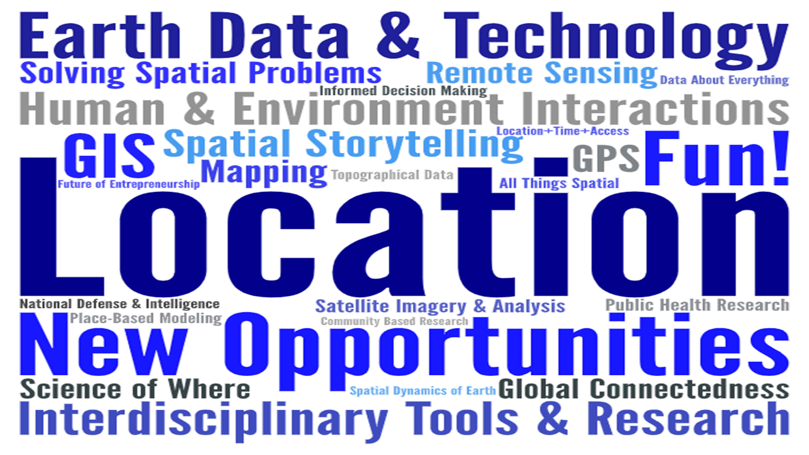

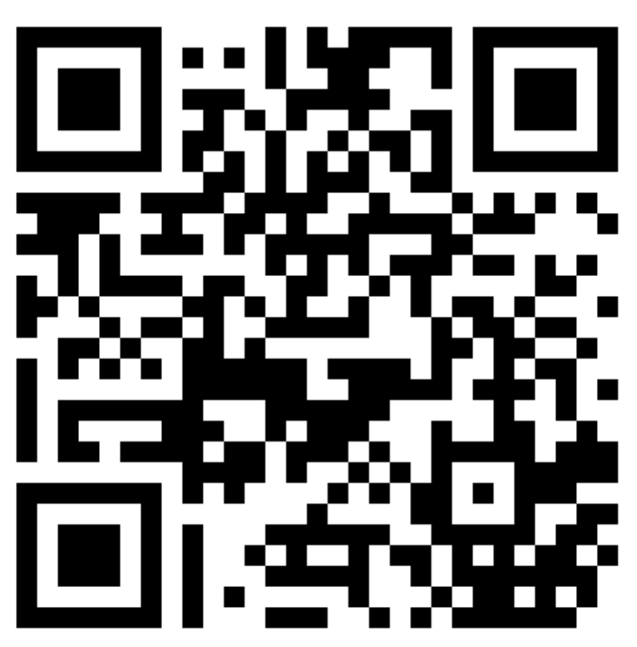
What Does Geospatial mean to you?
Save the date:
September 28th, 2023
St. Louis, MO

Slide 7
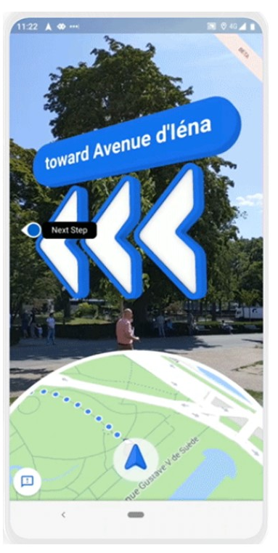
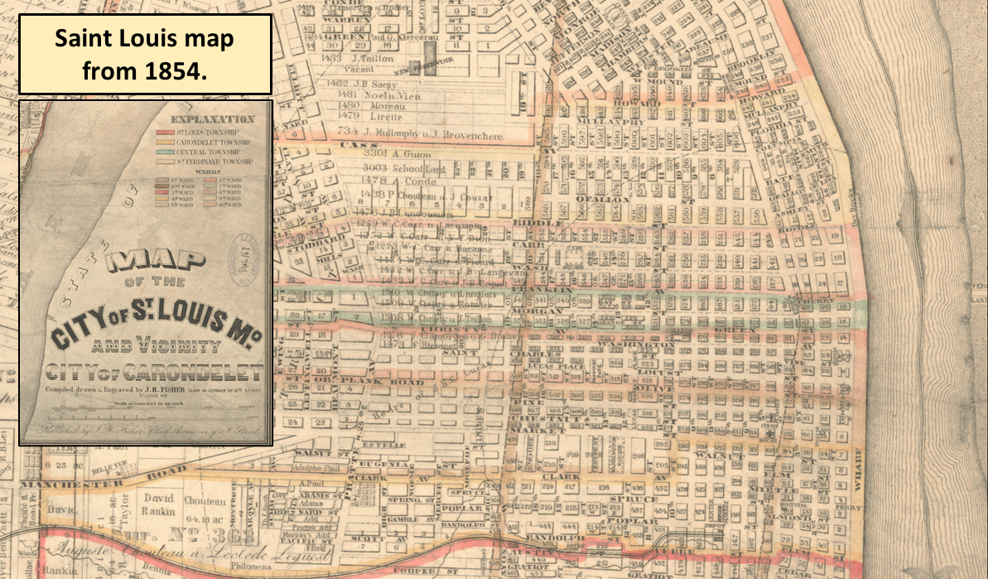

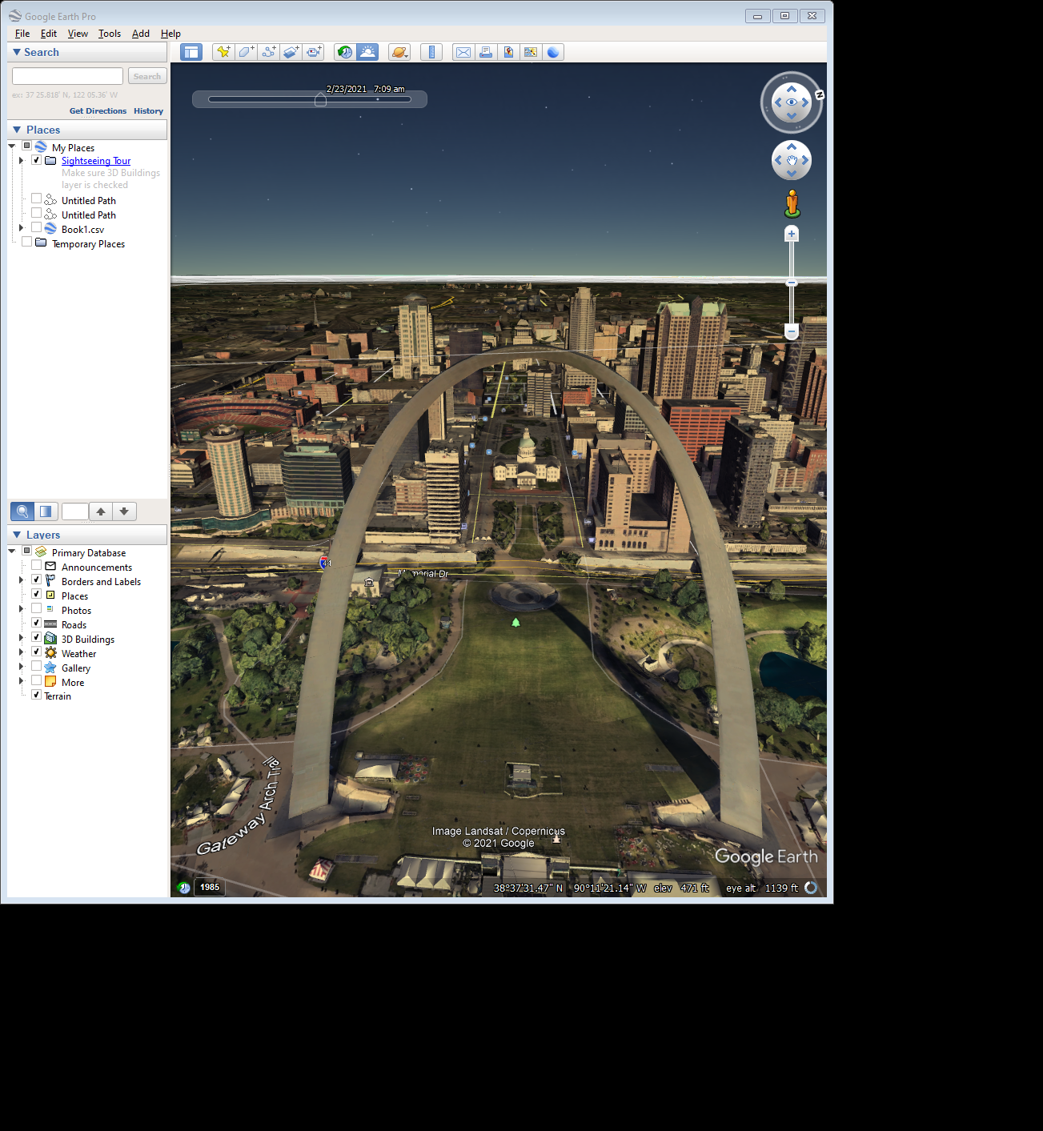
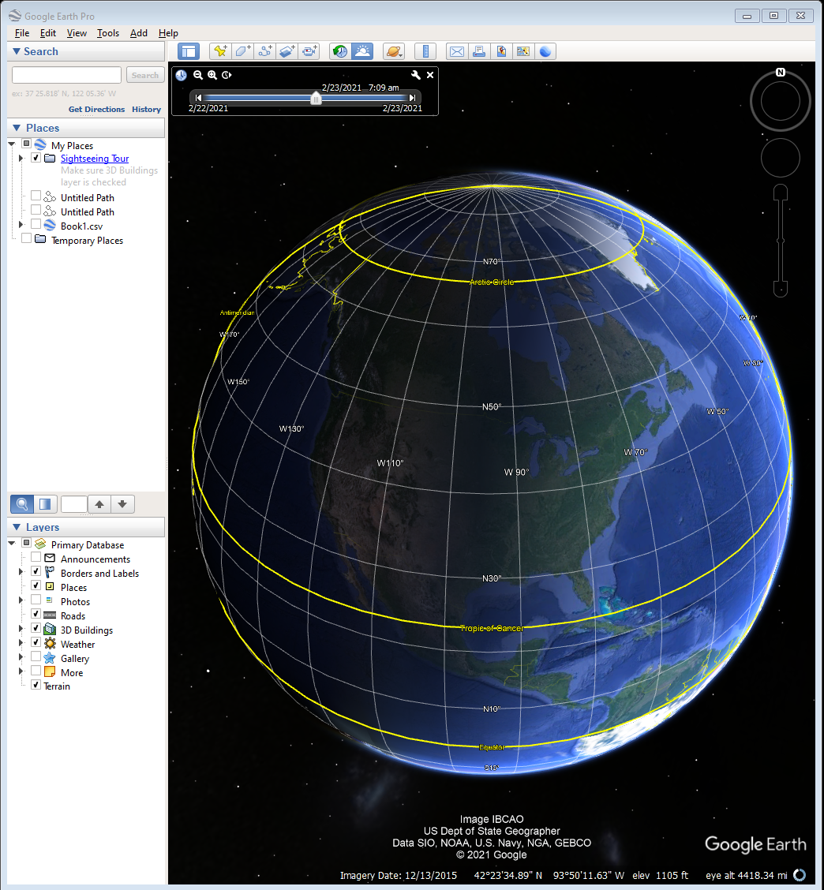
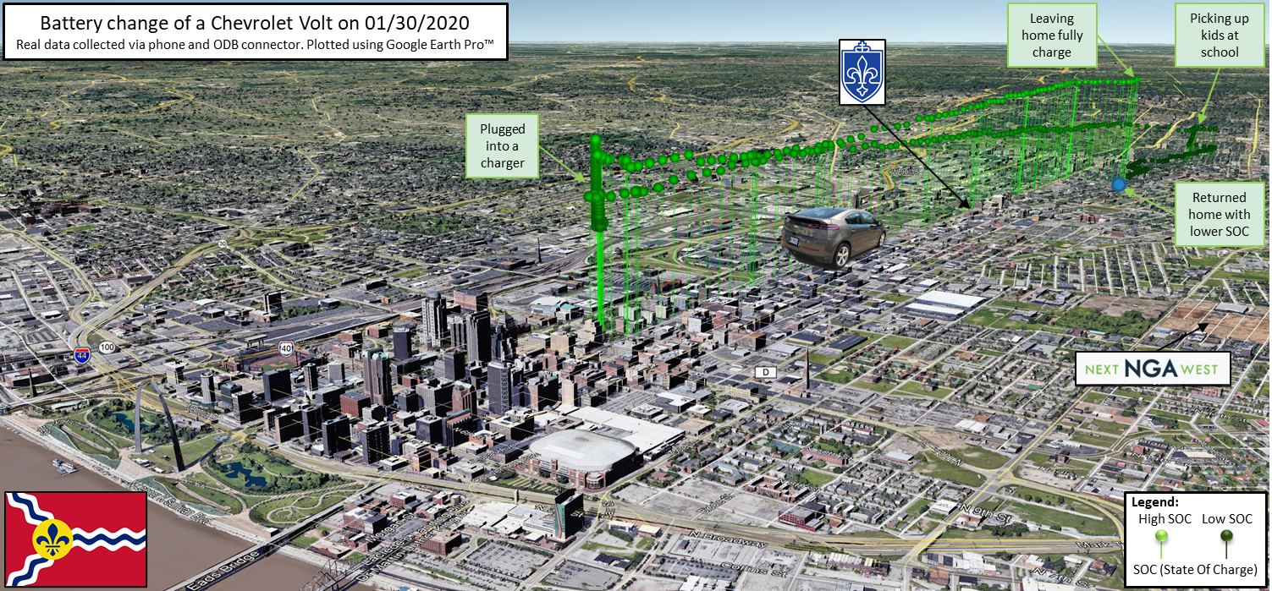
Tremendous Progress in Representing the World Around Us
Digital globe with 3D building
Google maps
with ‘Live View’
“Old school” map and compass
3D world with data overlay
Try Google Earth!

Slide 8
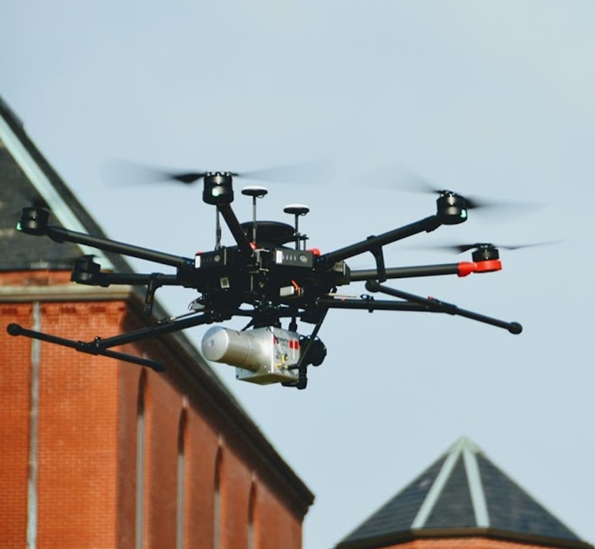







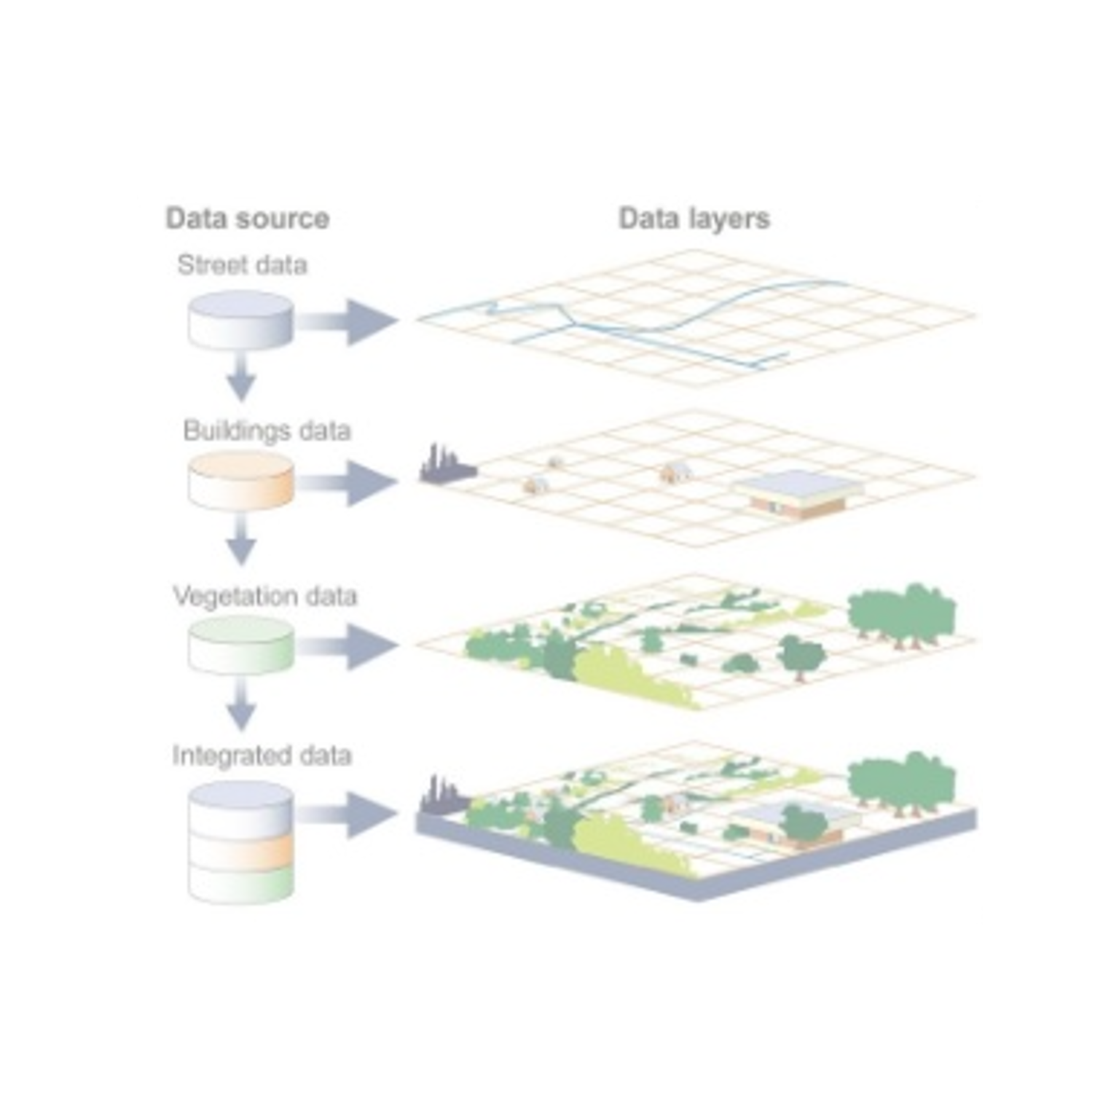
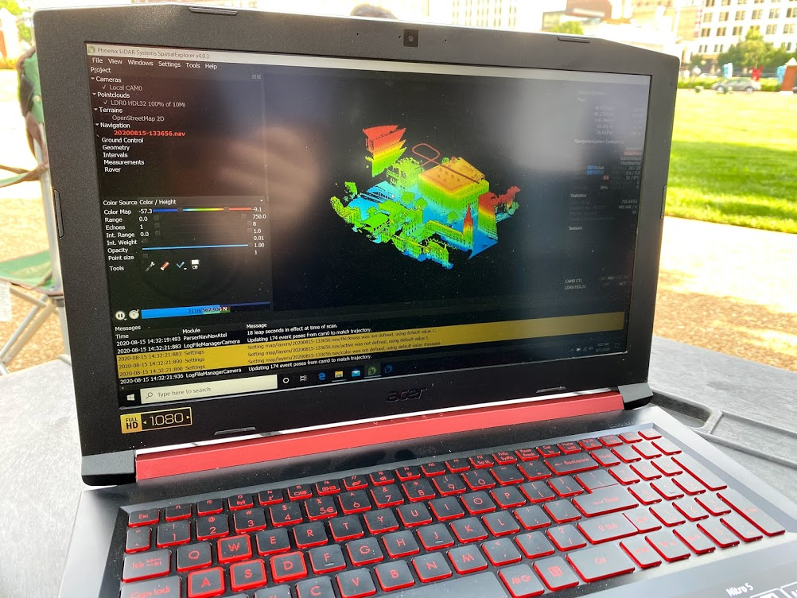










Geospatial Science: It’s a Science & a Tool
Spectral camera
Satellite
Global Food, Water, Energy
and Human Security
Remote Sensing
LIDAR
Position
Drone
Geospatial Sciences
Navigation
Social, Economic
Inequities
Timing
Maps
Public Health and Healthcare
GPS
Bio-Sciences
Climate Change
Geographic Information Systems
Data Analytics
Disasters and
Crisis Response
Emerging Technologies
Countering Wildlife Trafficking
Big data
Artificial Intelligence
Transportation and Supply Chains
Machine learning
Computer coding
Data management

Slide 9
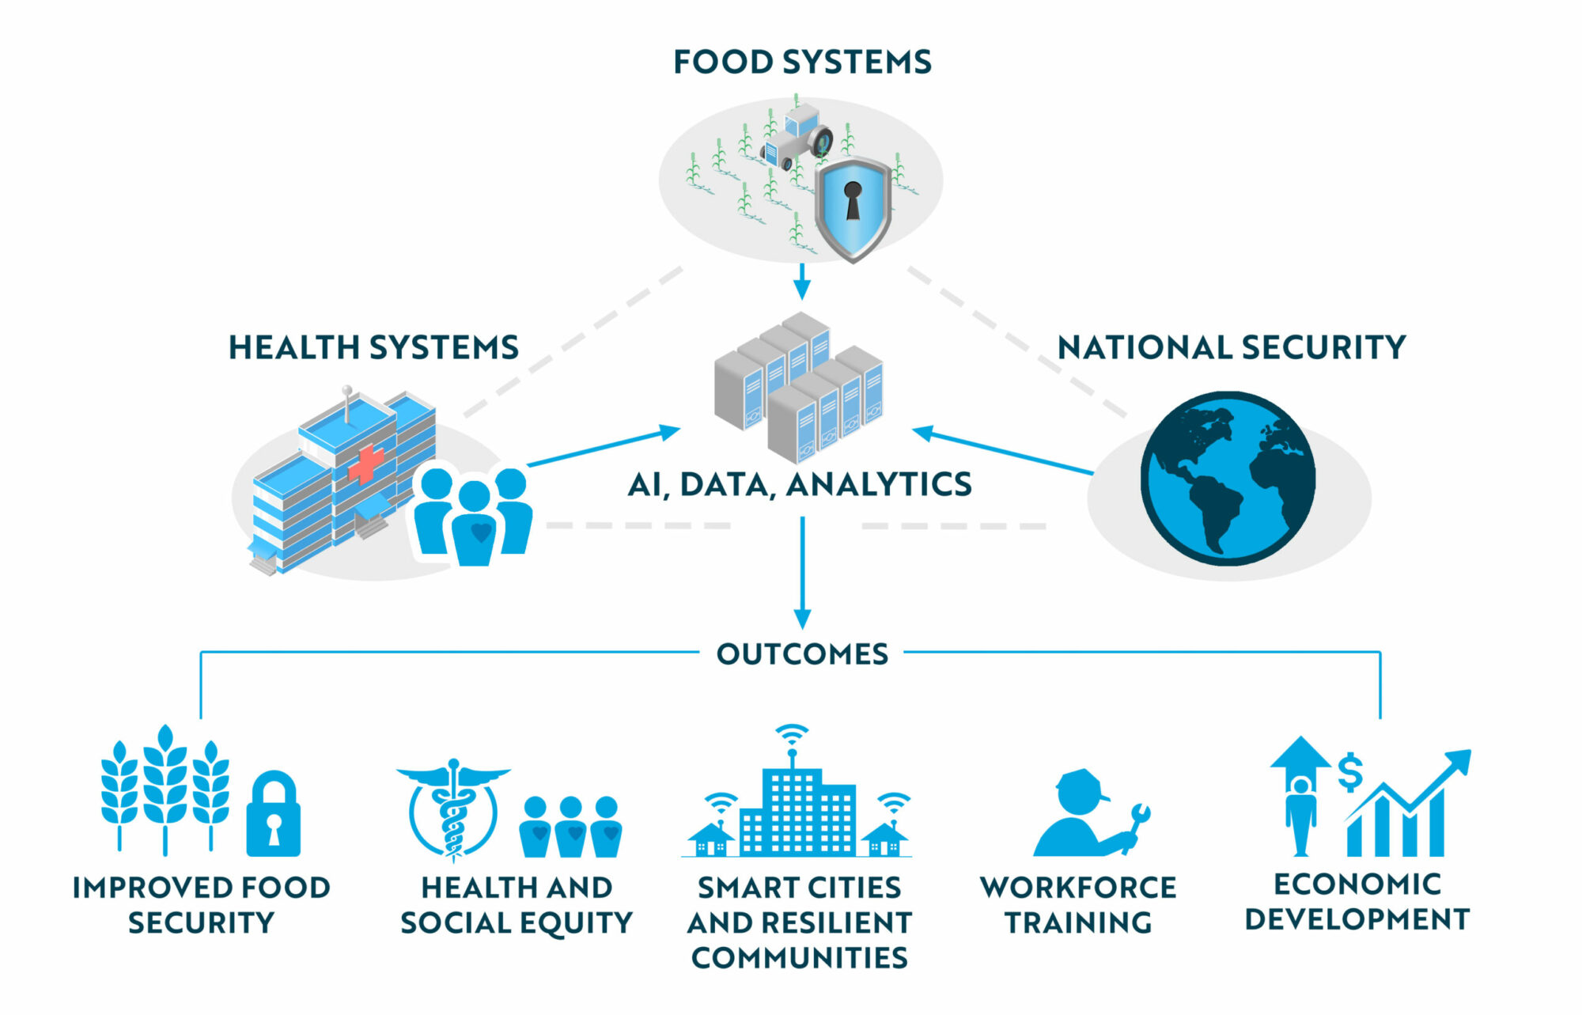
Addressing Grand Societal Challenges

Slide 10

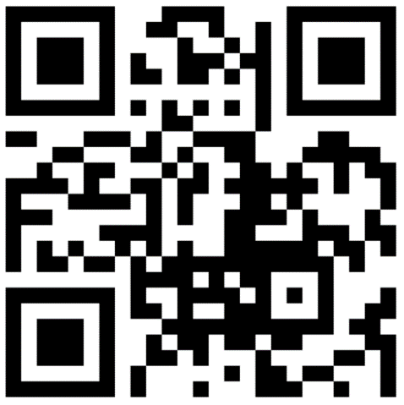
TGI Research Council Nov 2022

Slide 11
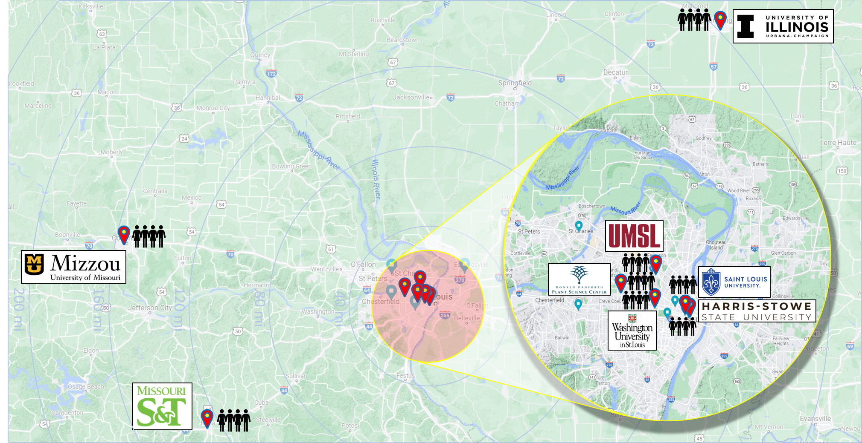
Location: Rooted in St. Louis & the Midwest
Nation’s Leading Geospatial Research Collaborative

Slide 12
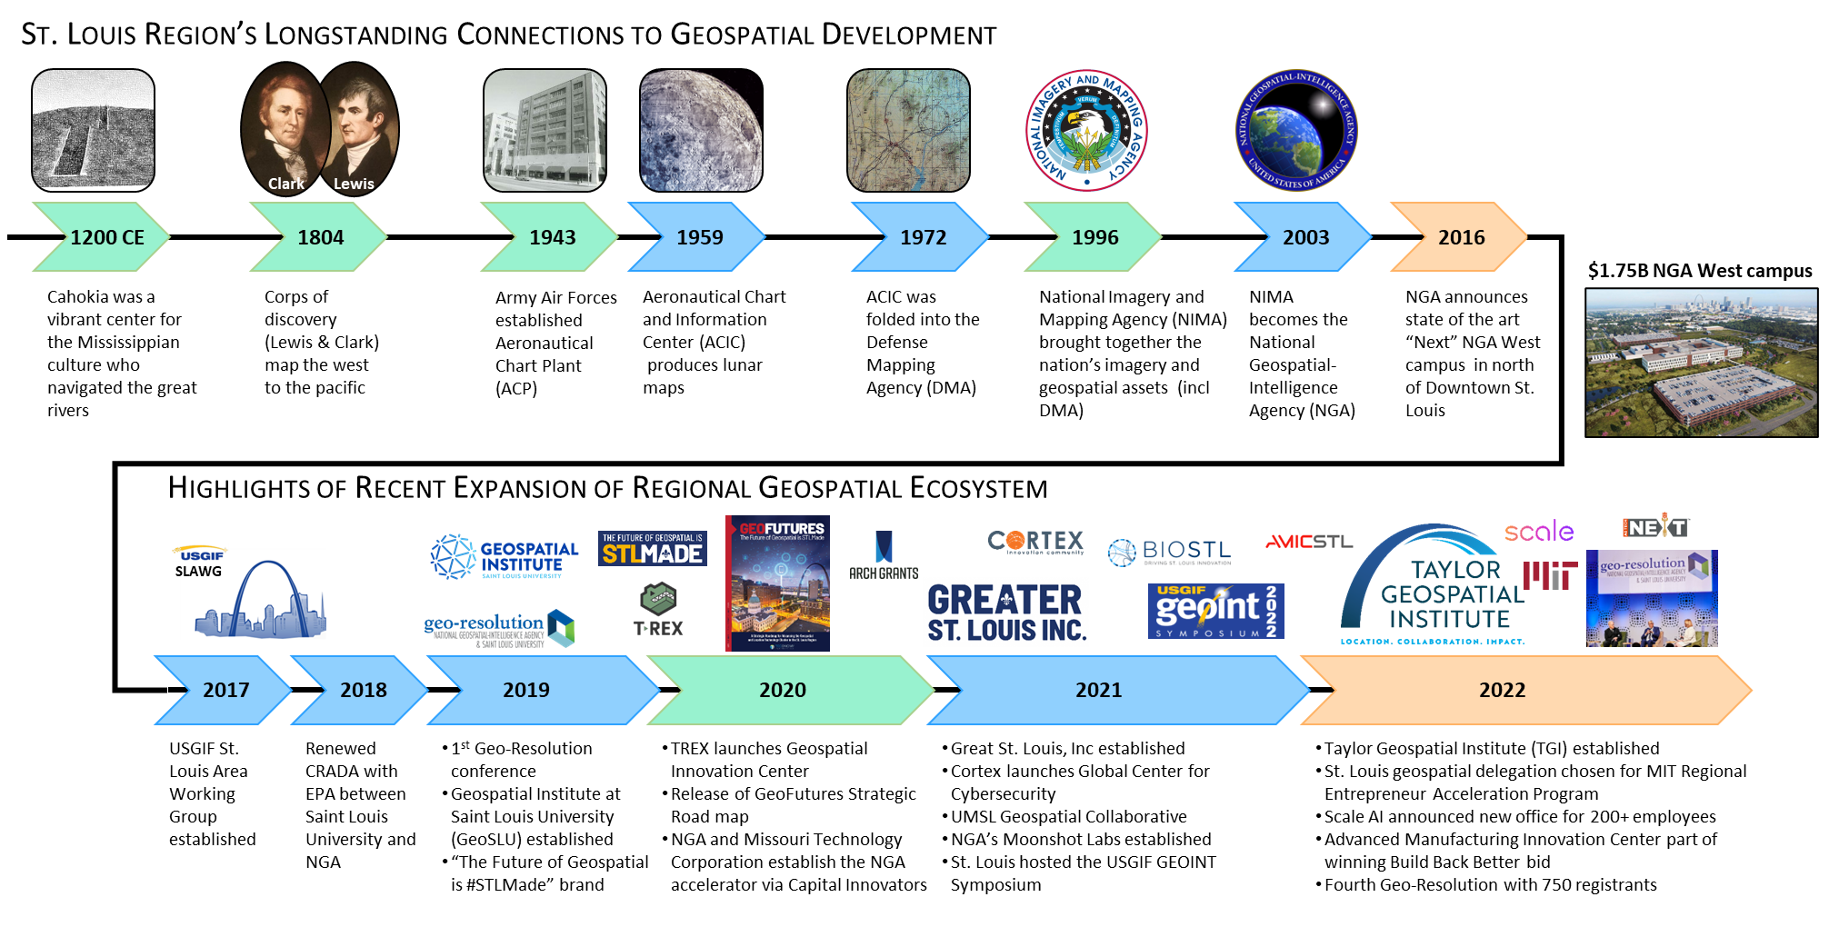
St. Louis’s History in Location Science

Slide 13
Collaboration

Slide 14


Radical Collaboration for Our Four Pillars
Build a world-class, interdisciplinary research collaborative
Translate research into impactful commercial applications
Over $4M in collaborative incentives in year one
Integrated in the TGI mission
Establish a comprehensive spatial science research infrastructure
Contribute to efforts to develop, maintain, and retain outstanding talent
Data access, Data collection, Data Analysis
Degrees, workforce dev., DEIA connected to the region

Slide 15




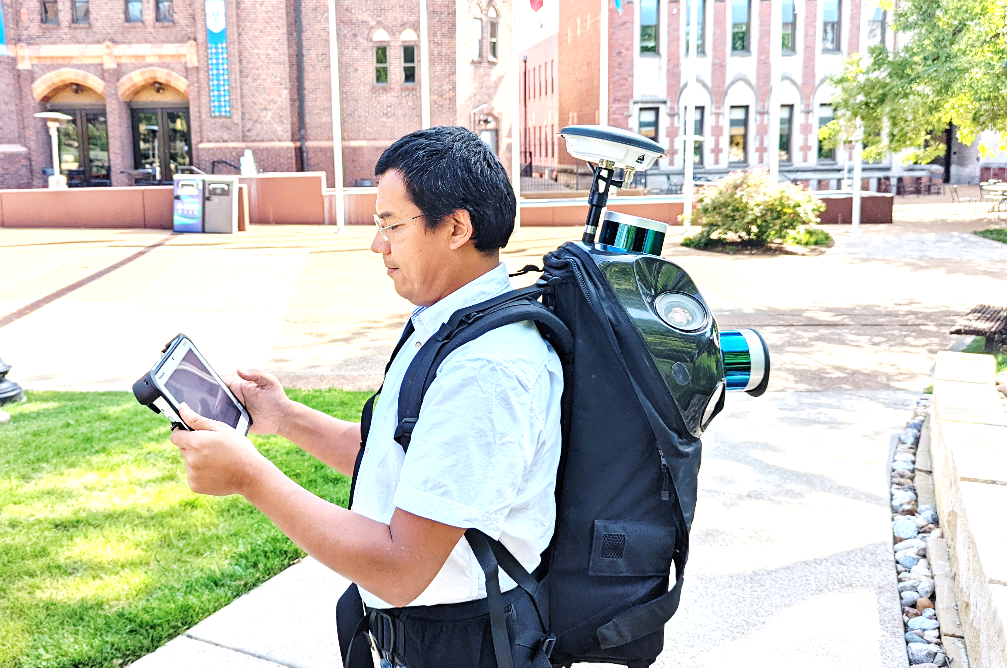
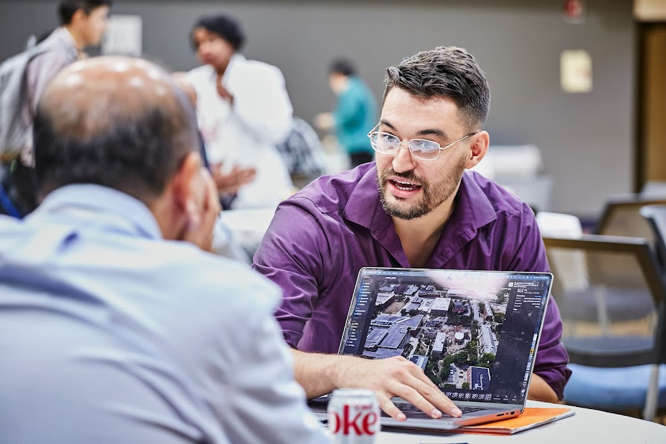
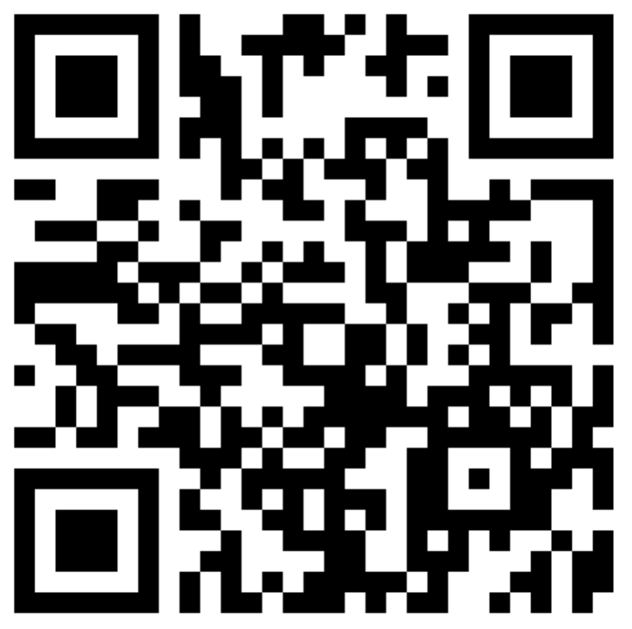
Collaboration with Industry in A Vibrant Regional Geospatial Ecosystem
Talent
Research
Technologies
PARTNER
WITH
US

Slide 16
Impact

Slide 17




















A Research Infrastructure Built to Make an Impact on the Consortium
GeoAI: AI, ML, DL,… HPC
Geospatial Data Analytics Library
Cloud
Local
Access to Existing Dataset
Research Computing
Data Needs for Researchers Across Disciplines
Insights, Visuals, and More Time to Focus on the Research
Data
Processing
Connection to
local industry ecosystem
Experts
Problem: Why? It takes 80% of research time to find/assemble quality analysis-ready data
Equipment
Outcome: Researchers have more time to focus on the actual research and implications
Custom data collection with portfolio of tools
Custom Data Collection
Results, Visualization

Slide 18
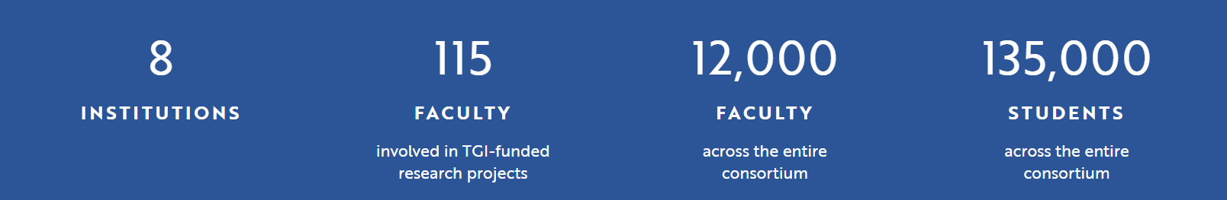
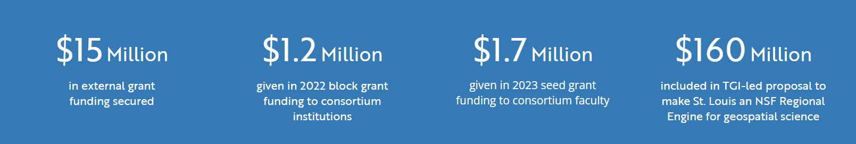
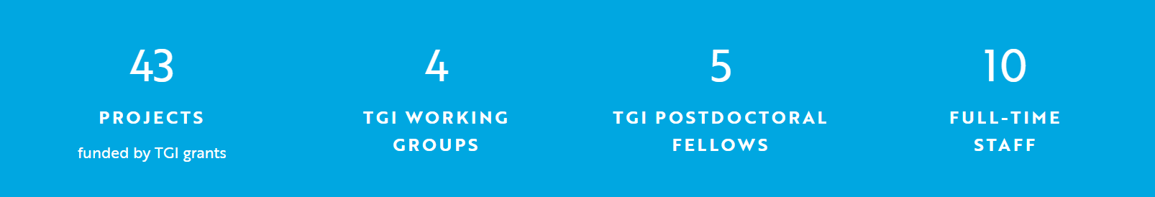
After Year 1: Impressive Impact

Slide 19

Special for Business Managers Governance & Leadership Structure
Note: GC, RC members are TGI ambassadors within their institutions
Governance Council
Monitors activities; Approves strategic direction; Approves funding allocations; Provides oversight to into initiatives
Multi-Institution Senior Leadership
Still being formed
Research Council
Develops funding mechanisms; Provides review of funding opportunities
Multi-Institution Scientific Leadership
Institute Leadership
Daily operation
Director, Associate Directors,
Data Team, Staff
Advisory Board
Strategic direction
Scientific, Industry, Academic Leaders
External Reviewer Pool
Business and Administration

Slide 20


Overview
Henning Lohse-Busch, Ph.D.
Chief of Staff
https://taylorgeospatial.org/

Slide 21
University Compliance Overview
Jessica evenson
vice President of University Compliance & Ethics

Slide 22
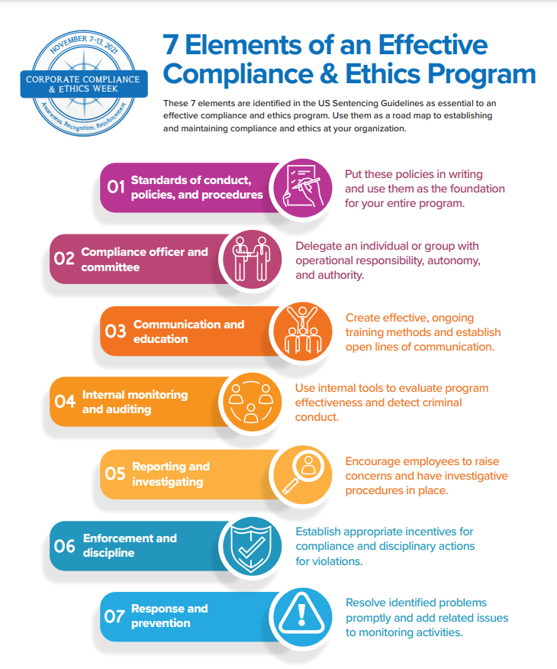
7 Elements of an Effective Compliance & ethics program

Slide 23

All members of the university community are responsible for ensuring we operate with honesty and integrity. If you suspect a violation of laws, rules, regulations, or policies affecting the university community, visit the following link to submit a report or raise a question or concern: slu.edu/integrityhotline

Slide 24
Human Resources Update
Aaron Mensinger
Learning & development manager

Slide 25
Employe Voice Survey

Slide 26

SLU Listens
In 2014 the Board of Trustees asked that we conduct a University wide climate survey
Survey conducted every two years up to 2020
Willis Towers Watson was chosen as vendor partner
Considered a valuable tool to gain a pulse on sentiment
Demonstration of administration’s commitment to listening to our community and taking action
Cura Program
Leading with Feedback Training
Start/Stop/Continue Exercise
Flexible Work Policy

Slide 27
Case for Change-What We’ve Heard
Challenges with historical survey approach
Delays between survey and distribution of results & action planning
Environment is changing quicker than a bi-annual survey can assess
Over complicated action plans too often miss team level impacts
Survey is too long!
Timing is right to evolve our Listening Strategy
More frequent, shorter connections help create an environment where employees feel valued and heard
Year 1 = One Survey Year 2 = Onboarding & Exit Surveys
New tools allow more engagement at the department level to increase engagement and drive culture
Year 1 = Executive Results Year 2 = Manager Level Results*

Slide 28

– A new Partnership
Simple, short, easy to complete surveys
25 – 30 questions vs. 60-70 with WTW
Intuitive dashboards for interpreting results
Simple action planning (1 – 3 items)
Just in time resources and videos for education (micro-learnings at the time of feedback review)
Consulting Services and Training to support our survey journey

Slide 29
Continuous Listening Model Approach
By doing this…..
Shorter surveys w/more qualitative comments
Providing rapid access to results
More active participants in local efforts
We hope to achieve…..
An environment of failing fast and course correcting
Better tracking of action planning efficacy
Trend results throughout the year vs year to year
Better support the goal of faculty/staff feeling heard

Slide 30
Implementation Journey
March - May
RFP and demo reviews with multiple vendors
Finalist reviews with Dr. Pestello, Dr. Lewis, David Heimburger and Mickey Luna
Selection (GLINT) and contract execution
June - August
IT technical setup (SSO, Workday Integration)
Employe attribute determinations for reporting
Stakeholder meetings and socialization planning
Draft survey development & training plan development
September - December
Survey finalization
Training plan refinement and execution
Survey lunch
Share results with teams

Slide 31
Things You Can Do
Start talking about accomplishments that have been achieved by your team.
Watch for communications regarding the rollout of the survey.
Encourage their participation in the survey.
Share results with your team when they are available.
Engage your teams in action planning.

Slide 32
Cannonball Conference 2023

Slide 33
Helping Ourselves to Serve Community and Serve God
Reinvigorate the Jesuit Mission of Saint Louis University​
Strengthen our University Community​
Spark Action and Resiliency in our Staff​
Celebrate University Accomplishments over the Past Year

Slide 34
Agenda
8:00-8:30 Continental Breakfast​
8:30-8:45 Transition to Welcome​
8:45-9:30 Welcome/Opening Remarks​
9:30-10:30 Breakout Sessions​/Campus Walk
10:45-11:40 Keynote Speaker​
11:45-1:00 Lunch​
1:00-2:00 Breakout Sessions / Campus Walk
2:00-2:15 Transition to Afternoon Mission Session​
2:15-3:15 Mission Video Session​
3:15-4:00 Volunteer Opportunities and Closing

Slide 35
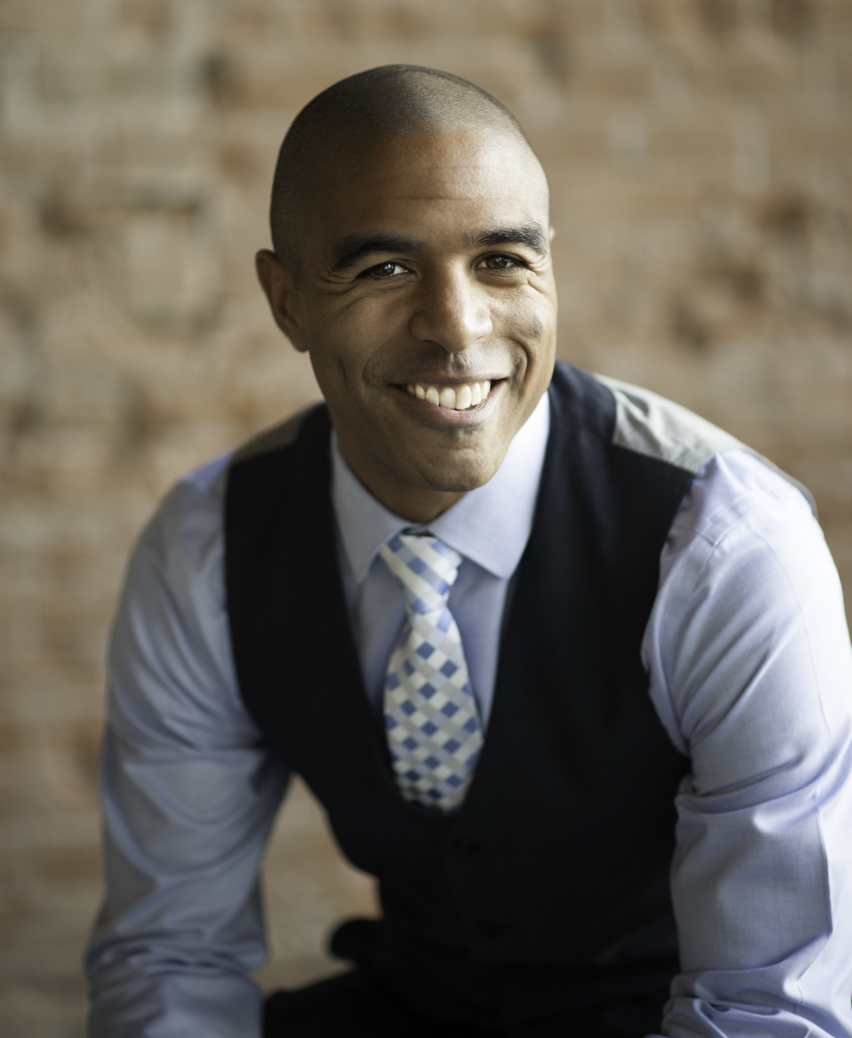
Keynote Speaker
Eric M. Bailey is the bestselling author and President of Bailey Strategic Innovation Group, one of the fastest-growing human communication consulting firms in the United States.
Eric has been featured on CNN, Huffington Post, Forbes, the Like a Real Boss Podcast and has helped leaders and teams across the world see common problems from new and different perspectives. Eric works with Google Inc, the US Air Force, Los Angeles County, the City of St. Louis, MO, Phoenix Police Department and many more. Eric also runs a YouTube series of 2-minute executive lessons called The Walking Meeting.
Eric has a Master’s degree in Leadership and Organizational Development from Saint Louis University and is a lifetime learner of human and organizational behavior.

Slide 36
Breakout Sessions
Breakout sessions are provided in the morning and afternoon
Topics Include
Emotional Intelligence
Mindfulness
Collaboration
Psychological Safety
SLU History
Reconnecting with Campus

Slide 37
Service Project
Partnering with Operation Food Search
Posters will be hung to identify needed items
QR code available if people want to give monetarily
Bins located around campus for employees to drop off donations
Suggestions on where to locate bins

Slide 38
Kickoff Webinar
Awakening The Passion In Your Life
Do you admire people who always seem excited and passionate about what they do? Whether it’s in their personal life, professional life, or both, some people are able to bring passion into their lives, while others struggle to find that spark to really get them going. Do you want to wake up every morning with great anticipation about what the day will bring?
September 26th, 9:00 AM
Registration
Registration link in August HR Bulletin

Slide 39
Next Steps
More communications coming out highlighting different parts of the day
Look for registration mid-late September
Please work with your teams to help them participate in any or all of the day.

Slide 40
Enrollment Update
Julianne Hunter
Director of business operations Provost Office

Slide 41
Supplier Updates
Jeff Hovey
Sr. Director of business Services
Mary Lynn Thompson
Contract Management Specialist

Slide 42
spend Management
Janet strader
planning & budget director

Slide 43
QUARTERLY SPEND MANAGEMENT PROCESS
Unrestricted Funds
Review Cost Center YTD activity by ledger account/spend category, prepare an estimate for the fiscal year, and explain variances (i.e., estimate vs. budget and vs. prior year-end).
Designated Funds
Review Cost Center YTD fund balances and explain material changes (i.e., significant revenues, expenses, transfers in/out) for gifts, programs, and/or projects.
Spend Management Analysis Instructions
Report: CR-FIN-Budget vs Actuals by Org
Report: CR-FIN-Fund Balance
Screenshots with Prompts
Examples

Slide 44
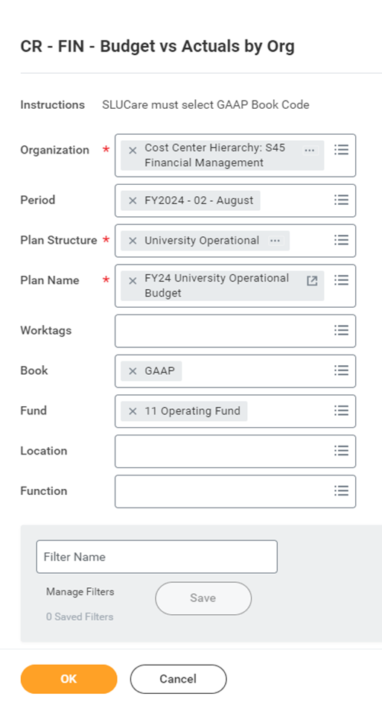
OPERATING FUND REPORT PROMPTS

Slide 45
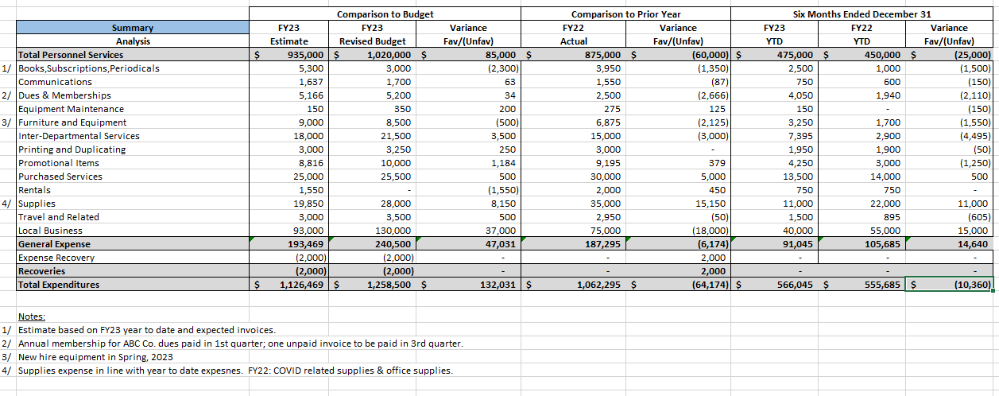

OPERATING EXPENSE analysis example

Slide 46
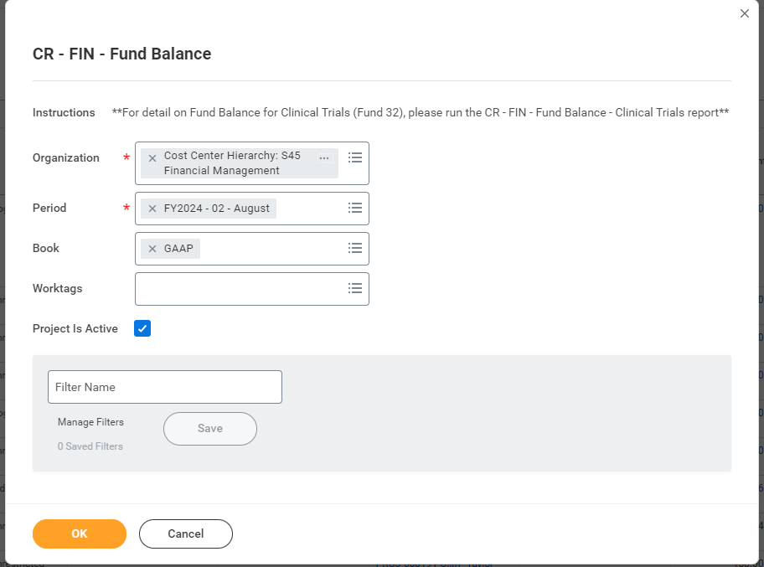
Designated fund report prompts

Slide 47
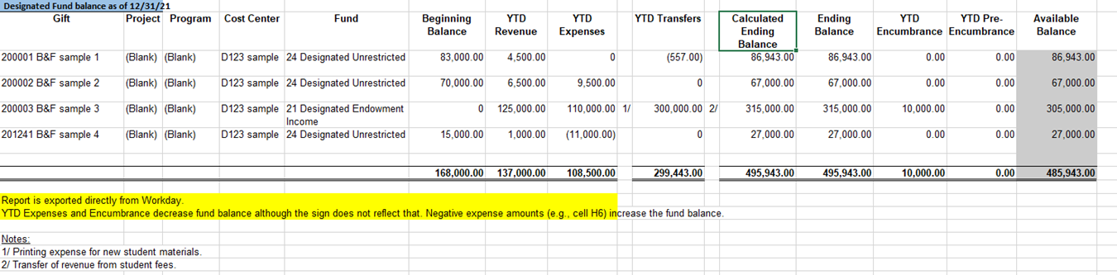
Designated fund analysis example

Slide 48
Questions?
Business & finance
budgetoffice@slu.edu

