Slide 1

Business Manager Meeting
September 2020

Slide 2
Agenda
SLU Business Manager Meeting
September 10, 2020, 9:00a.m.-10:30a.m.
Next meeting March 11, 2021
Announcements
Introduction of New Employees
Future Business Manager Meetings
Solicit input on future meeting topics
budgetoffice@slu.edu
Updates from the Following Areas
Business Services Agiloft Updates – Ellen Borowiak, Manager
Housing & Residence Life - Manisha Ford-Thomas, Director
HR Updates - Mickey Luna, Vice President
ITS Updates – Tim Murphy, AVP User Services
SLUCare Updates – Tara Thomason, Director
Workday Report Demonstration – Brianne Burcke, Assistant Controller & Director; Crystal Santa Cruz, Application Systems Analyst

Slide 3
HR Agenda
Review Termination/ Job Change Process
I-9 Process Painpoints

Slide 4
Hiring/Terminations Q&A
When do I need to create a new position?
New positions are needed when a new role is created in the department.
When do I need to create a job requisition to post the new position?
A requisition is needed if you are going to gather applicants through a competitive interviewing process. It may also be necessary if a volunteer is converting to a paid employee.
If an internal candidate applies to the requisition, do I proceed with hiring them through the requisition or do I start a job change on that employee?
In this instance, you should complete the hiring process. When Human Resources kicks off the offer/hire process, it will automatically result in a job change.
When should I do a job change/promotion?
Job Changes should be processed for in-line promotions, demotions, changes in role, FTE. Examples are full-time employee dropping to part time or faculty member taking on administrative responsibilities

Slide 5

Situational examples
Situations:
Employee resigns to work for another organization - Termination process should be initiated.
Employee is currently full-time, has resigned full-time role, and is moving to part-time - Job change to move to part time status should be initiated
Adjunct moving to full time position - adjunct should apply for the full-time position via an internal candidate application. When hired, the process will complete as a job change.
Employee resigns from dept A to take role in dept B - dept A should not terminate the employee. Job change process initiated by HR through requisition hiring process to move employee
Full-time faculty member has applied for emeritus status before retirement - termination should be initiated and contingent worker contracted for the date following the termination.

Slide 6
Common I-9 Pain Points
Hire Date/Workday Entry
Employees cannot attempt to complete the I-9 before the hire is successfully completed in Workday
The Hire Date must be the first day the employee will begin to work
Rehires
Rehires between systems Banner > Workday require a new I-9
Rehires within Workday > Workday to not require a new I-9 within 3 years
Out-of-State Hires/COVID Exceptions
Must be in Missouri, Illinois, Rhode Island, California, Colorado or Massachusetts
Cannot be used for locals employee, even if they will be working remotely

Slide 7
Common I-9 Pain Points
General Process Issues
Employees should be notified of the I-9 requirement during the offer
Managers/Business Managers should be utilizing the templates in the 8/3/20 communication
International Employees must be authorized to work in the US
Reminder: Section 1 of the I-9 should be completed on or before the first day of work. This piece done in Workday and needs to be completed before Section 2 can be started.
Section 2 of the I-9 must be completed by the third day of work. Due to COVID-19, we are scheduling appointments with employees who need to complete the I-9.
Employees will receive a certificate showing they completed the I-9 and managers should not allow people to work if they do not the certificate.

Slide 8
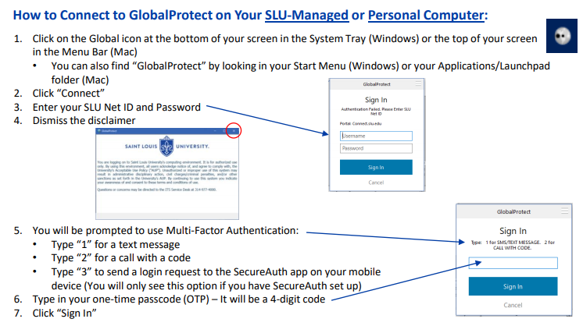
Working Remote – GlobalProtect VPN
Connecting with GlobalProtect VPN
a secure way to access specific SLU systems and services
From your SLU owned device or your own personal computer
Why?
Access to specific apps labeled “On Campus Only” with MySLU.slu.edu
Allows you to receive application and security updates via the SLU network
Notes:
“On Campus Only” –AppXtender, Cognos, Voicemail

Slide 9
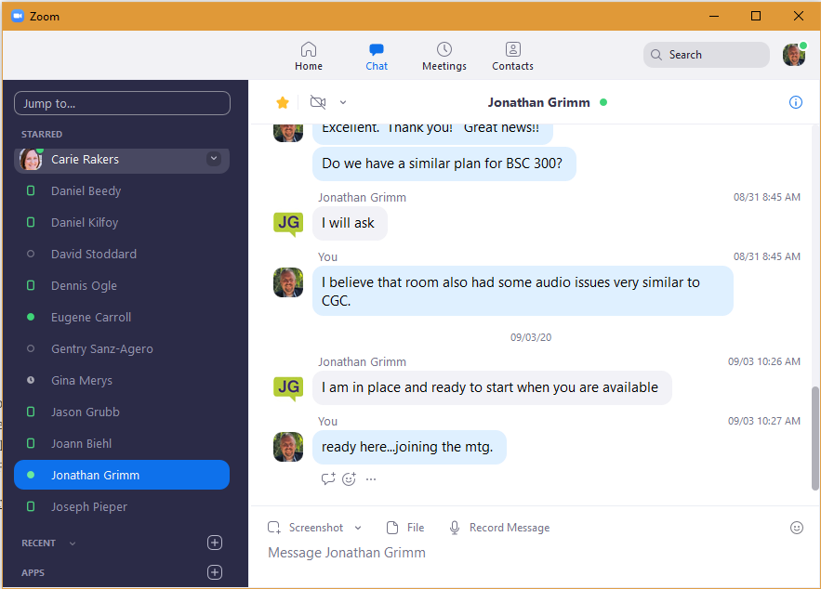
Working Remote – Zoom Tips
Zoom Tips at SLU ATC
Quick Start Guide
Recording Meetings
Sharing Content
Waiting Rooms
Securing Zoom Meetings
Tips for Improving Your Zoom Experience
Network Bandwidth
Turn Off Video
Check your Internet Speed
Wired Connectivity
Use a headset & mute when not actively speaking
Zoom Chat
Similar to Skype – “Starred” Contacts
Desktop and Mobile Applications
Efficient way to do a “remote drive by”

Slide 10

Windows 10 Upgrades - Update
Initiated project in 2019 to upgrade/replace all Windows 7 devices to Windows 10 by end of 2020
Project was delayed due to impact & efforts to support pandemic
Status:
62% of SLU devices are Windows 10
Moving forward
Aggressive approach this year to reduce Windows 7 devices to more than 15% by end of 2020
additional cost to support/maintain Windows 7 + added security risk to the University
Identified 600+ devices that can be upgraded w/o purchasing a new device
Understanding that departments are spending time and money elsewhere due to pandemic – allow exceptions through the end of 2021
Ask that departments forecast for any remaining replacements for July-December 2021
Notes:
Total Workstations – 7,172
Current Windows 10 – 4,468 - 62%
Current Windows 7 – 2,694 - 38%
2,397 desktops
279 laptops
15 unidentifiable machines (i.e. – VM and bootcamp)
Other – 10 (Windows 8)

Slide 11
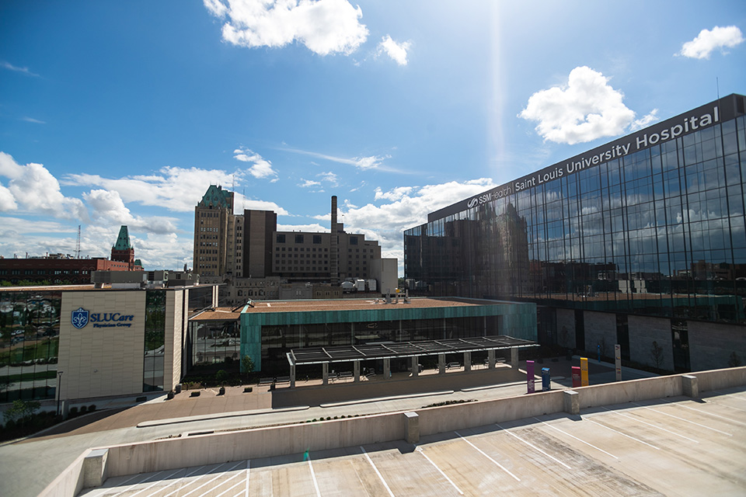
Center for Specialized Medicine & SSM Health SLU Hospital
SSM Health Saint Louis University Hospital and Center for Specialized Medicine (CSM) opened Sept 1st
CMS (formally ACC) determined to be a finance lease under ASC 842
Lease signed in March 2020 with SSM; 30 year lease
SLUCare leasing ~ 70% of the building
PV of future lease payments ~ = FV of the building
Lease liability and corresponding right to use asset of ~$31M recorded on balance sheet as of 6/30
Interest expense and amortization expense recorded monthly beginning July 2020
In process:
Allocating CMS rent expense, and related CAM charges, to departments based on square footage
Reviewing auxiliary share service contracts (IT infrastructure agreement, registration space agreement, etc)

Slide 12
Workday Reports Demo
Job Aid Crosswalk: Financial Reports
Reports:
CR – FIN – Budget vs Actual by Org
CR – FIN – Statement of Account
CR – FIN – Report of Transactions – Org
CR – FIN – Fund Balance

Slide 13
Workday Reports Demo
Tips
Manage/Save Filters
Help Text
Prompt Options – Multiselect (square) vs Single (circle)
Arrows:
Expand or collapse report lines
Drop down options for amounts
Full screen viewing mode
Sorting/Filtering
Drill Down to Details
Export to Excel
Grid Preferences

Slide 14
Workday Reports Demo
Reports are a work in process
Play around
Issues? Let us know!
Questions?

